Slide 1
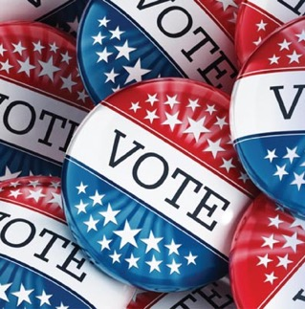

The 2020
General Election
What to expect and how to prepare
A NON-PARTISAN GUIDE
lwvsmc.org
09/05/2020
Notes:
Using this toolkit to keep voters and poll workers safe—and encourage voter turnout.
This toolkit teaches how to Register, Commit to voting, and then Vote—safely, from home.
WHEN YOU ARE IN THE PRESENTATION MODE, clicking on the blue links in the presentation will take you directly to the indicated webpage. You exit the Slideshow mode by pressing ESC.
We are also promoting the use of www.VOTE411.org, the League of Women Voters website with complete voting information.
If you have any questions, email us at lwvsmcnj@gmail.com or text us at 732-927-1131.

Slide 2

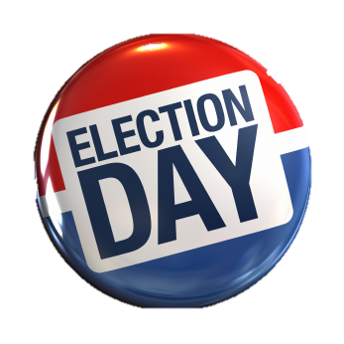
The 2020 General Election
Voters face important choices
President
U.S. Senate
House of Representatives
County Clerk
Two Freeholders
Municipal and School Board offices
Three NJ Constitutional Ballot Questions
  Extend the property tax deduction and exemption to Peacetime Veterans
  Legalize recreational marijuana
  Reschedule redistricting if Census data is delayed
2
Notes:
Both GOP candidates for Congress in New Jersey’s 6th district have been tossed off the ballot for not having enough signatures, leaving Rep. Frank Pallone (D-Long Branch) unopposed unless a Republican can secure 100 write-in votes in the July 7 primary election.
Marijuana Legalization Amendment. A "yes" vote supports egalizing the possession and use of marijuana for persons age 21 and older and legalize the cultivation, processing, and sale of retail marijuana.
A "no" vote opposes this constitutional amendment
The five-member Cannabis Regulatory Commission (CRC), first established to oversee the state's medical-marijuana program, would be responsible for regulating the cultivation, processing, and sale of recreational marijuana.^{[1]}
The state sales tax (6.625 percent) would apply to recreational marijuana but prohibit additional state sales taxes. The state Legislature would be authorized to allow local governments to enact an additional 2 percent sales tax on recreational marijuana.^{[1]}
The ballot measure would not provide additional specifics, such as possession limits, home-grow rules, and retail regulations; rather, the legislature and CRC would need to enact laws and regulations.
(Supported by 68% of likely voter and 61% of registered voters)
Tax Exemption Amendment. The ballot measure would expand the state’s $250 property tax deduction for wartime veterans to include peacetime veterans as well. It would also expand the 100 percent property tax exemption for disabled wartime veterans with total and permanent service-related disabilities to disabled peacetime veterans.
Extending redistricting . Would postpone state legislative redistricting until after the election on Nov. 2, 2021, should the state receive federal census data after February 15, 2021. Current state legislative districts, would apply for the 2021 The constitutional amendment would also use this delayed timeline in future redistricting cycles should federal census data be received after February 15 in 2031, 2041, 2051, and so on.

Slide 3

The 2020 General Election
A major complication
COVID-19
NEW JERSEY*
  194,000 cases
  15,945 deaths
* As of August 31, 2020
New York Times
3

Slide 4


The 2020 General Election
The complications compound
Covid-19 threat to voter and poll worker safety
Shortage of poll workers
Consolidation of polling places—confusion, long lines
New online voter registration (9/4)
Unprecedented numbers of mail-in ballots
Printing, handling, and delivery challenges
Strain on postal system—volume, need to postmark mail-in ballots
Quantity and location of Drop Boxes
Spiking costs; uncertain funding
New unfamiliar procedures
Misinformation campaign
Foreign interference
4
Notes:
(Robert Hubbell, August 3, 2020) The Post Office is in trouble. It has been in trouble continuously since 2006. Why? In 2006, Congressional Republicans imposed a special rule on the Post Office. It requires the Post Office to account for its retirement obligations in a way that no other federal agency is required to do. As explained by the Institute for Policy Studies,
In 2006, Congress passed a law that imposed extraordinary costs on the U.S. Postal Service [that] required the USPS to create a $72 billion fund to pay for the cost of its post-retirement health care costs, 75 years into the future. This burden applies to no other federal agency or private corporation.
The Post Office is big. ‘You just won't believe how vastly, hugely, mind-bogglingly big it is.’ It delivers 472 million pieces of mail each day. If the number of mail-in ballots doubled from 2016 (a very generous assumption), then 60 million ballots would be mailed over a four week period (of six day weeks) before November 3, 2020. That would mean the Post Office would handle about 2.5 million pieces of additional mail each day—a daily increase of about one-half of 1% (0.005). Given that there are 31,322 Post Offices in the U.S., the additional volume per Post Office is roughly 100 extra pieces of mail per day. Of course, much of the mail-in vote will come in the last week, which would mean that the average post office would see three hundred pieces of additional mail per day. Another way to look at the scale of the mail-in ballots is to consider that the ballots will be delivered to about 5,000 local election jurisdictions in the U.S.—or about 12,000 ballots mail-in ballots per jurisdiction over a four week period.
Of course, many offices would see tens (or hundreds) of thousands of additional pieces of mail per day, but those Post Offices would be of larger scale and proportional in size to their service population. On a relative basis, the uptick in their daily volume would feel like a one-half of one percent increase.

Slide 5
How it will work
2020 General Election
RECOMMENDED
In Person
By Vote-by-Mail Ballot
Fewer polling places*
50% of normal count county wide; at least one per municipality
Paper (provisional) ballots
Machine for voters with disabilities
YOUR OWN Vote-by-mail ballot drop-off
All standard Covid-19 precautions
Mail-in ballots mailed automatically to active, registered voters (By October 5)
4 ways to return ballots
    Secure drop boxes*
    USPS (Postage pre-paid)
    Polling sites Election Day*
    Board of Elections offices**
* Voters will be sent poll locations in separate mailing (sent 10/23)
** In person to 300 Halls Mill Rd., Freehold
Notes:
For the upcoming November 3, the rules for both In-Person and By-Mail voting are changed to keep voters and poll workers safe.
IN PERSON: It will still be possible to vote in person, but there will be fewer polling places Everyone will vote on a paper ballot—called a provisional ballot. Only people with disabilities, for whom voting on a paper ballot is a hardship—like the blind, will vote by machine at the polls. (E.O. 177 says “”accommodations will be made for voters with disabilities.”) All the Covid-19 rules—like 6-ft. social distancing, wearing masks, sanitizing the polling place, etc.—will be in force. NEW FOR GENERAL ELECTION: YOUR OWN vote-by-mail ballot can be hand delivered to YOUR OWN polling place. (You cannot carry and deliver someone else’s ballot.) A poll worker will validate that you are the person who filled out the ballot—that is, you will sign the poll book.)
BY VMB BALLOT: Every active* registered voter will receive a vote-by-mail ballot. They can return the ballot anyone of the four ways listed on the chart.
The Deadlines for the VBM ballot arriving at the Board of Elections by mail has been changed, as explained on a later chart.
* INACTIVE VOTER: Someone who has had a mailing from the Board of Elections returned to it as “cannot deliver” is marked in the registration rolls as “inactive.” If the inactive voter does not confirm or change the address with the Commissioner of Registration within two federal elections, they are deleted from the voting rolls. An inactive voter can go to the polls to vote in person and vote by provisional ballot. A voter can call the Board of Elections to check their active/inactive status: 732.431.7790. The state database has been modified; voters now see if they are active or inactive when they check their registration status.

Slide 6
The safest way to proceed
Make a plan to . . .
Commit
Vote
Register
1
2
3
FROM HOME!
6
Notes:
This material teaches how to Register, Commit to voting, and then Vote—safely, from home.
WHEN YOU ARE IN THE PRESENTATION MODE, clicking on the blue links in the presentation will take you directly to the indicated webpage. You exit the Slideshow mode by pressing ESC.
We are also promoting the use of www.VOTE411.org, the League of Women Voters website with complete voting information.
If you have any questions, email us at lwvsmcnj@gmail.com or text us at 732-927-1131.

Slide 7


Deadline:
21 days before the election
GENERAL ELECTION November 3, 2020
Registration Deadline
Don’t’ delay. Register early!
7

Slide 8
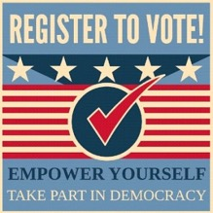
Who’s eligible to register?
A U.S. citizen
At least 17 years old
(But you can not vote until you turn 18)
A resident of the county for 30 days before the election
Not serving a prison sentence for a felony
NEW ! You can vote if you are on parole or probation but you need to register—even if you were registered before.
8
Notes:
Voting eligibility
First things first. A voter must be REGISTERED. This slide lists the voter registration requirements in New Jersey.
A recent change in requirements for voting (effective March 2020) is that people who are on parole or probation can vote, but they MUST REGISTER OR RE-REGISTER, if they were previously registered.

Slide 9

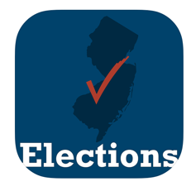

Are you already registered?
Multiple paths to the same destination
NJ voter-registration database
https://www.state.nj.us/state/elections/voter-registration.shtml
Note: Currently the NJ registered voter database does not include 17 year-olds who have registered but are not yet eligible to vote.
9
Notes:
[ALL THREE GRAPHICS ARE HYPERLINKS
Checking Registration Status
Several paths to the state database (shown here).
NOTE: Confirming that 17-year-olds are not listed in the public-facing database (8/30)

Slide 10
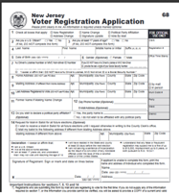
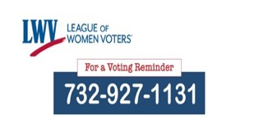

How do I get a application?
Voter Registration
^
Text for help
Print the form at home
https://www.state.nj.us/state/elections/voter-registration.shtml
Or
MonmouthCountyVotes.com
Request the form from the LWV
Text “NEED FORM” to 732-927-1131.
We’ll be in touch and mail one to you
Note: Forms are available at the Election Office, 300 Halls Mill Rd., Freehold (732-431-7780 x 7786) and at most libraries, town halls, etc.
10
Notes:
Registering to Vote/ Updating a Registration
In normal times, you can pick up a Voter Registration Application in person at the County Board of Elections Office at the county seat (Freehold for Monmouth County) or your town hall, or at registration drives held by the League of Women Voters and others.
To get a Voter Registration Application from home:
Find the form online – Forms in 14 languages are available on the NJ state elections site which can be reached by entering the state website URL on the slide or by simply Googling “NJ Voter Registration Form” to get to the state website. Scroll down to your County and chose either English or Spanish. Other languages are available under “Statewide forms” at the end of the list of counties. The forms can be filled out (but not submitted) online, downloaded, and printed (at 100% size). By mid-July, you will able able to complete AND SUBMIT the voter registration application online at the state website. But we are urging people to register NOW for the upcoming primary election.
--OR--
Text “REGISTRATION FORM” to the League of Women Voters at 732-927-1131. They’ll be in touch and mail a Voter Registration application to you.

Slide 11


On-line registration option
You need a form of identification and a way to provide a signature . . .
  Either through Motor Vehicles
    NJ Driver’s License, OR
    NJ MVC Non-Driver ID
OR—using your Social Security Number and entering your signature
    Sign on screen, OR
    Scan and upload
https://voter.svrs.nj.gov/register
Available since 9/4/2020
11
Notes:
Online registration
Expected to be available to NJ licensed drivers and citizens having a NJ Non-Driver Identification Card.* Signatures for these individuals are in the state databases. This is the first phase of the state’s implementation of online voter registration.
* New Jersey residents 14 years of age and older may apply for a non-driver photo identification (ID). The non-driver ID is issued solely for the purpose of providing identification and is not a license to drive. If customers have driver’s licenses from another state they are not eligible for a non-driver ID card.

Slide 12

Completing the Voter Registration Form
How to Register Voters in NJ Workshops
VIDEO
Online form
Notes:
Adapt the level of detail to the time and interest of the audience. In appropriate, click on the “How to Register Voters in NJ Workshops” hyperlink to show how to register for a workshop devoted to the subject. The link takes you to the lwvsmc.org homepage The big red button in the upper right opens a list of upcoming forums and workshops with registration links. Check before the webinar to confirm registration workshops are upcoming,
Show—at a high level—how to complete a VOTER REGISTRATION APPLICATION. There are three options for how to do this:
Stay on this slide and talk about the highlighted lines on the form.
Click on the “Online Form” hyperlink. It will take you to an interactive form on which you can fill in, real time, explaining as you go. If this is your choice, print a copy of the slide to support you as you narrate filling in the form. You must be in the “Slideshow” mode for the hyperlink to work.
Click on the “VIDEO” hyperlink and play the League of Women Voter video (~8 minutes) showing someone filling in the form. You must be in the “Slideshow” mode for the hyperlink to work. (Can adjust setting in Vimeo to speed up. It’s rather slow.)
Show—at a high level—how to complete a VOTER REGISTRATION APPLICATION. There are three options for how to do this:

Slide 13
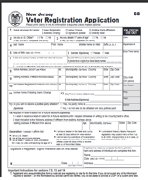

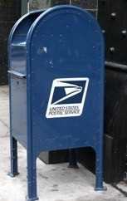
Submit your Voter Registration Application
Fold and tape (not staple) your form
and drop it in a mailbox.
Your form is already addressed and stamped.
  (Or, deliver in person to the Superintendent of Elections/Commissioner of Registration Office, 300 Halls Mill Rd. Freehold)
Don’t wait!!
DEADLINES
Postmarked 21 days before Election Day (October 13)
Once registered, you stay registered and do not need to submit another form unless you change your address, name, signature, or party affiliation.
13
Notes:
Mail your completed Voter Registration Form/Application
It is vitally important that you follow the directions for submission exactly. If you print the form yourself, you will have two pages. Fold them so that the address shows on the outside when it is sealed. Tape the pages so that they don’t come apart in the mail.
There are deadlines for registration. In NJ, your voter registration application must be received by the county Board of Elections 21 days prior to the election in which he or she wishes to vote. The registration deadlines for the Primary and General Election are shown on the slide.

Slide 14
Commit
Commit
Vote
Register
2
1
3
14

Slide 15

No Excuses!
Are you thinking…?
Voting by mail is hard.
It doesn’t matter who is elected. They all act the same once they are in office.
This is such a crazy time. I’m too preoccupied to vote.
My faith in the system and fairness in voting is utterly crushed.
My mail-in ballot won’t be counted.
My vote is largely symbolic because of the Electoral College. I live in a ”blue” state.
15
Notes:
Here are some possible responses to the excuses on the slide, or you can make up your own as appropriate.
Voting by mail is hard – “Yes, it is a little confusing this year, but I can walk you through all the steps. I’m here to help!”
My mail-in ballot won’t be counted – “As long as it is received by the deadline, it will be counted. If you are concerned about the postal service, you can submit your ballot via a secure drop box that has daily pickup, by bringing it to your polling place on election day, or even by bringing it to the Board of Elections office in Freehold by election day. After you vote, you can track your ballot at the NJ Division of Elections Public Access site ( https://voter.svrs.nj.gov/auth/sign-in)”
This is such a crazy time. I’m too preoccupied to vote – “We are all nervous about the Covid-19 virus and the effect it has on every aspect of our lives. That is why it is important to vote for the candidates who you think will be able to handle the crisis and its aftermath in the best way.”
It doesn’t matter who is elected. They all act the same once they are in office – “There are real differences between candidates. You can look them up on vote411.org to see where they stand on various issues. And you can ‘attend’ the virtual candidate forums sponsored by the League of Women Voters.”
My vote is largely symbolic because of the Electoral College. I live in a “blue” state – “The Electoral College applies only to the election for President. Your vote counts directly in county, local, and Board of Education elections. And there are some important questions on this year’s ballot”
My faith in the system and fairness in voting is utterly crushed – “Faith in the system and fairness in voting are important in a democracy. Not voting, however, allows someone else to make all the decisions that will affect your future. In a democracy, voting gives you the best shot at making democratic elections work. Giving up that right means democracy dies.”

Slide 16
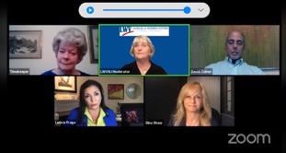
Learn about the candidates and issues
Vote411.com
Detailed candidate information at all levels
Information about ballot questions
COVID-19 related election changes
Check registration status
Find a first-time voter checklist
Candidate Forums
lwvsmc.org for information and to register
Monmouth Co. Freeholders and Clerk
Wed., October 14
Local Municipal and Board of Education
Various dates
16
Notes:
VOTE411
VOTE411.org is the League of Women Voters nonpartisan voters guide that provides customized information on voting. Users enter their address and can see what will be on the ballot when they vote. They can see biographical information and answers to League-posed questions from candidates who respond to the League’s invitation to participate.
VOTE411 provides candidate information down to the local level, information on ballot issues, updates on COVID-19-related changes to elections, and links that allow users to check their registration status and much more.
Candidate Forums
The hyperlink takes you to the lwvsmc.org home page. The big red “Forums and Workshops Register” button opens the list of upcoming events, including any forums that have been scheduled, with links for registration. The registration for for forums asks only for first name and zip code—and offers a way to submit questions in advance.

Slide 17
Finally . . .
3
VOTE
2
1
Register
COMMIT
17
Notes:
The League of Women Voters is strongly encouraging those who can to vote by mail. (Each municipality will have at least one polling place where voters will cast paper ballot and those with special needs can vote by machine.)
The material that follows shows how to vote by mail

Slide 18

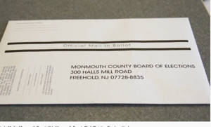
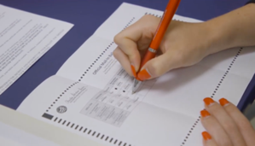
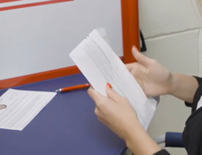
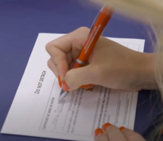
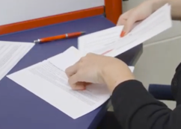
Filling out the VBM ballot
1
2
VIDEO
How to vote by mail
You’ll receive a package in the mail.
It contains your ballot and two envelopes.
Fill in the circles on the ballot to mark your choices. Use a blue or black pen—not pencil or marker. The ballots are scanned by machine.
3
4
5
Put the ballot in the certification envelope.
Do not detach or damage the flap!
Complete the information on the outside of the smaller envelope and sign.
Place the certification envelope in the outer envelope and seal.
It is self-addressed and stamped.
Notes:
Walk quickly through the steps shown on the slide. The Administrator of the Board of Elections requests that we stress:
voters must provide a street address on a the certificate of Mail-In Voter (Step 4)
You are allowed to help someone with the mechanics of filling out their ballot. You are NOT allowed, however, to cast a vote for someone else. If you have helped someone (for example: by reading the ballot aloud, by explaining the boxes to check, by pointing out where to sign, etc.) you must sign the area indicated on the inner envelope.
Click on the “VIDEO” hyperlink and play the 4-minute LWV video on Voting By Mail in Monmouth County. You must be in the “Slideshow” mode for the hyperlink to work.
SAMPLE CERTIFICATION FORM (from 2020 NJ Primary)

Slide 19

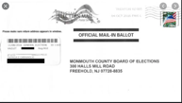
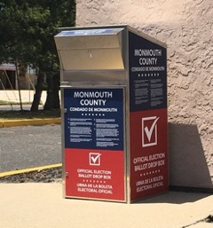
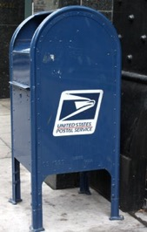
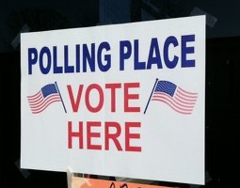
Submit your ballot
RECOMMENDED
Secure Drop Box
US Post
At the polls
Daily pick-up direct to election office
DEADLINE: 8 PM Election Day
Video surveillance at all locations
DEADLINE:
If postmarked by Election Day, received by 11/10.
If no postmark, received within 48 hours of close of polls.
Only your own ballot!
At least one polling place per municipality; 50% of regularly used sites per county
Ballots can be delivered in person on or before Election Day to Co. Board of Elections, 300 Halls Mill Rd., Freehold
Notes:
The U.S. Election Assistance Commission recommends having one drop box for every 15K to20K voters. At least 20 stats do not have any drop boxes for voters and many more do not have as many as the EAC recommends. (Slate, “What Congress needs to do now to secure election day, July 30, 2020)
NJ Executive Order 177:
Polling places: the county Boards of Elections shall designate each polling place as a location to receive voted mail-in ballots. A voter may return only the mail- in ballot that they personally voted to their designated polling place.
Drop Boxes: each county shall have at least a total of ten (10) secure ballot drop boxes in locations that are readily accessible to the registered voters within the county.
USPS: Every vote-by-mail ballot that is postmarked on or before November 3, 2020, and that is received by November 10, 2020, at 8:00 p.m. shall be considered valid Every ballot without a postmark, and ballots mis-marked and confirmed by the post office that those ballots were received by the post office on or before November 3, 2020, that is received by the county Boards of Elections from the United States Postal Service within forty-eight (48) hours of the closing of polls on November 3, 2020, shall be considered valid

Slide 20
Monmouth County Drop Boxes
Locations announced by 9/15
MonmouthCountyVotes.com
17 in Monmouth Co.
(pending state approval)
Installed by 9/22
Notes:
The U.S. Election Assistance Commission recommends having one drop box for every 15K to20K voters. At least 20 stats do not have any drop boxes for voters and many more do not have as many as the EAC recommends. (Slate, “What Congress needs to do now to secure election day, July 30, 2020)
NJ Executive Order 177:
Polling places: the county Boards of Elections shall designate each polling place as a location to receive voted mail-in ballots. A voter may return only the mail- in ballot that they personally voted to their designated polling place.
Drop Boxes: each county shall have at least a total of ten (10) secure ballot drop boxes in locations that are readily accessible to the registered voters within the county.
USPS: Every vote-by-mail ballot that is postmarked on or before November 3, 2020, and that is received by November 10, 2020, at 8:00 p.m. shall be considered valid Every ballot without a postmark, and ballots mis-marked and confirmed by the post office that those ballots were received by the post office on or before November 3, 2020, that is received by the county Boards of Elections from the United States Postal Service within forty-eight (48) hours of the closing of polls on November 3, 2020, shall be considered valid

Slide 21

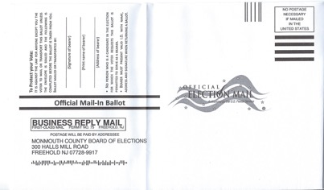
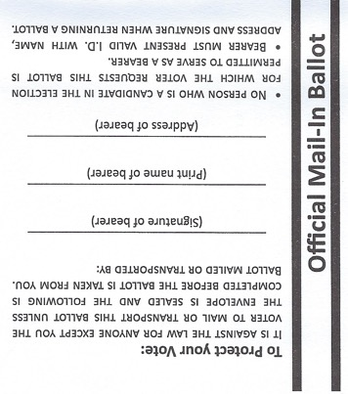
If you use a “bearer”
If someone else mails or drops off your ballot, they must fill in the “Bearer” information on the outside envelope.
Bearer can deliver no more than three ballots
Notes:
“We had a conference call this afternoon with the State Division of Elections to discuss recent election legislation and its impact on our November 2020 General Election process. It was confirmed that the increase to 5 Bearer ballots for family members living in the same household does not go into affect until 2021; therefore, the limit is still three (3).” Aug. 31, 2020
Robin Major, Administrator
Board of Elections
(732) 431-7802, ext. 2750

Slide 22

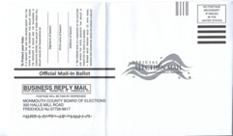
Are vote-by-mail ballots safe?
25.8% vote-by-mail
(31 million)
The data makes the case
  Since 2000, 250 million mail-in ballots cast; 143 criminal convictions for election fraud
  Five states (CO, HI, OR, UT, WA) use vote-by-mail primarily; few- to-no fraud cases
Safeguards are in place
  Identity verification
  Bar codes
  Secure Drop Boxes
  Harsh penalties
  Post-election audits (statistical
  anomalies)
74.2% in-person voting
2018
Mid-Term Election
Notes:
May 2020: Alleged fraud in Paterson NJ Municipal Election
All vote-by-mail election, as pandemic precaution.
Irregularities reported (Post Service found hundreds of mail-in ballots in one mailbox). Under investigation.
2018: Blade County, NC
Fraud uncovered by postelection audit.
Political operative submitted absentee ballots that were not filled out by voters.
Election invalidated. New election held
When someone tries an absentee ballot scheme like this clumsy attempt in Paterson, it is hard to hide. People get caught.”
Rick Hasen, Univ. Calif, Irvine, Law Professor
(NPR “Why is Voting by Mail Controversal?, June 4, 2020)
Forty-six states now offer access to some form of mail voting to all voters, according to a recent report from the nonprofit Open Source Election Technology Institute. Overall, that expansion has been bipartisan; 24 of the states have Democratic governors, and 22 have Republican governors.
Overall, experts estimate as many as 70% of all ballots cast in November's general election could be cast by mail.
143 convicted election fraud cases since 2000

Slide 23
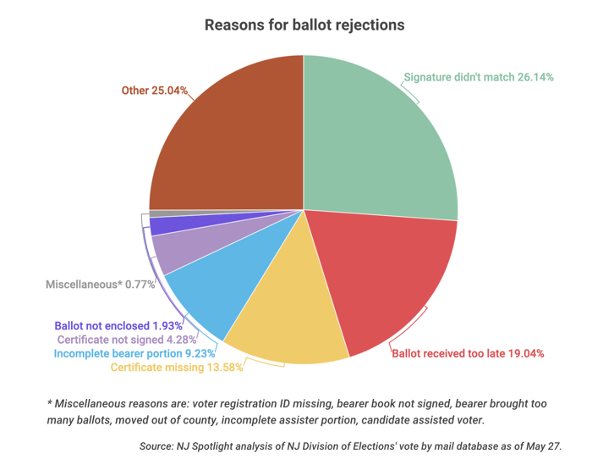
Mistakes mean rejection
The stakes are high
119,000 ballots cast
(17.4% of those sent; 31 communities)
11,453 (9.6%) rejected*
May 2020 NJ all VBM local nonpartisan elections
Reasons for ballot rejections
* Includes 800 rejections in Paterson election—ballots found in bundles in mailboxes. If Paterson removed, rejection rate was 8.1%
Miscellaneous 0.77%
Voter registration ID missing, Bearer book not signed, Bearer brought too many ballots, Moved out of county, incomplete assister portion, candidate assisted voter
Signature mismatch 26.14%
Ballot not enclosed 1.93%
Certificate not signed 4.28%
Ballot received too late 19.04%
Incomplete bearer portion 9.23%
Certification missing 13.58%
Notes:
NJ Spotlight, June 10, 2020: Colleen O’Dea, “One in 10 Ballots Rejected in Last Month’s Vote-by-Mail Elections.”
May all-VBM local elections exceptionally higher rejection rate. (3% in 2018 General Election)
Most common reasons: Signature mismatch, ballot arrived late. Required certificate was not enclosed
LWLVNJ and NAACP are plaintiffs in suit against the state demanding that voters whose ballots have been rejected have a chance to “cure” (correct) the problem in time for the primary election

Slide 24
After the May NJ nonpartisan VBM elections
What’s been done to improve the process
For 7/7 Primary
For 11/3 General
Signature mismatched/missing
Voter notified and allowed to “cure”
Policy: favor approval
Voter notified and allowed to “cure”
Signature curing process begins 10/13
Policy: favor approval
Ballot received too late
Drop boxes
Deadline for receipt extended for ballots postmarked by election day moved from 48 hours to 7 days
More drop boxes
Your polling place takes your VBM ballot
Deadline for receipt extended
  For ballots postmarked by election day moved from 48 hours to 7 days
  For un-postmarked ballots, 48 hours from close of polls
Ease of submitting
Postage pre-paid
3 ways to return ballot
Postage pre-paid
4 ways to return ballot
Timely results
Ballot counts start 10 days before election day.
  No tallies until 8 PM 11/3
  Criminal penalty for “leaking”
Rejection rate dropped from ~10% to just under 3%
Notes:
"Cure forms will indicate a deadline date to cure ballots. Voters should make sure to read the form and return prior to deadline date and time. Board of Elections waiting for additional information from State regarding deadlines for Mail-in and Provisional Ballots that need to be cured.” Administrator, Monmouth Co. Board of Elections, Aug. 31,2020
Nationally, more than 300K absentee ballots were rejected in the 2016 presidential election. (U.S. Election Assisstance Commission via wpr.org)
STATES VARY ON VOTE-BY-MAIL PRACTICES: 29 “No Excuses” states allow residents to vote by mail without an excuse. Another five states send ballots to all registered voters without requiring a request for one. 9 States required a witness signature to submit an absentee ballot. Another 3 require at least two witnesses or a notary (Brookings Institution)
WISCONSIN PRIMARY EXPERIENCE: 2016 and 2018 Wisconsin General Elections, absentee ballots =<6% of all ballots counted. 2020 Wisconsin Primary: 60%.

Slide 25
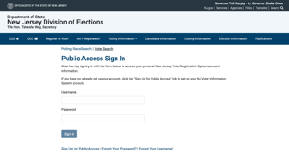
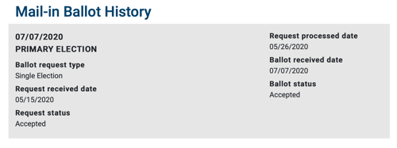
How to know your ballot was counted
You will be notified automatically by mail if your ballot is rejected.
NJ Voter Public Access Sign Up
https://voter.svrs.nj.gov/auth/sign-up
OR - Call Board of Elections Office 732-431-7802 x. 7150
Notes:
We gave the state and county phone numbers to check individual ballot status in our Primary webinar, but turns out they did not work
The state elections website has a Voter Public Access feature where a voter can set up an account and have access to their voting history, including the status, when available, of their most recent vote-by-mail ballot
Setting up an account is problematic for voters whose registrations go back more than ~15 years. These voters need to enter their Voter ID number—and number most voters don’t know. THE VOTER ID NUMBER IS PRINTED ON YOUR VOTE-BY-MAIL BALLOT. Make note of it if you want to set up a Voter Public Access Account.

Slide 26
Take-aways
  Encourage and help everyone you know to register.
  Update your signature of record if you are unsure.
  Complete and submit your vote-by-mail ballot as soon as you are comfortable. We recommend using a Drop Box.
  Be a resource for others.

Slide 27
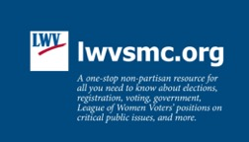

Text for help
MonmouthCountyVotes.com
MonmouthCountyVotes.com

Slide 28
Back-up slides

Slide 29

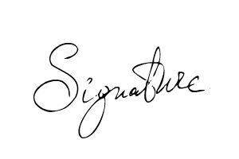
The signature curing process
Match or no match?
Board of Election staff compare signatures
VBM ballot to signature on record as it appears in the poll book
Questionable matches go to the Commissioners on the Monmouth County Board of Elections
Half Democrats, half Republicans
Commissioners vote
Remedy
Curing letter sent to voters who ballots are rejected for signature match or missing signature
Voters must act on the curing letter within the stated deadline
Notes:
Board of Election staff compare signatures
Questionable matches go to the Commissioners on the Monmouth County Board of Elections (6: 3 Democrats, 3 Republicans)
Commissioners take a vote
Curing letter sent to voters who ballots are rejected for signature match or missing signature

Slide 30
Use pen, not pencil!
How to fill out the Voter Registration form
Online form
VIDEO
Notes:
Here you show students how to complete a VOTER REGISTRATION FORM. There are three options for how to do this:
Stay on this slide and talk about each field on the form.
Click on the “Online Form” hyperlink. It will take you to an interactive form on which you can fill in, real time, explaining as you go. If this is your choice, print a copy of the slide to support you as you narrate filling in the form. You must be in the “Slideshow” mode for the hyperlink to work.
Click on the “VIDEO” hyperlink and play the League of Women Voter video (~8 minutes) showing someone filling in the form. You must be in the “Slideshow” mode for the hyperlink to work.
NOTE: How you return to the Slideshow from the hyperlinks varies, depending on your hardware and software platforms. How it works for you may influence your choice of option (staying on the slide, filling in the online form and narrating yourself, or showing the video.)

Slide 31
The Truth About Voting by Mail
A non-partisan explanation
Notes:
What can you do as a Voting Advocate
Covid-19 may mean that most or all of us will need to cast our votes using vote-by-mail. Many people have never done so before, and they may need assistance and encouragement to do so. The people you talk to may not be registered and may also need assistance with voting by mail. We hope you can be the person who will help them overcome barriers to voting.
This toolkit includes a ‘how-to’ presentation that equips you to help others vote in the upcoming elections safely by using the vote-by-mail process. It includes two short videos, and will help you talk with others about:
How to check to see if they are already registered to vote, and, if not, how to register.
Why we may need to use mail-in voting this year for health and safety reasons.
How to request and then cast a mail-in ballot.
Offering your help and encouragement.

Slide 32
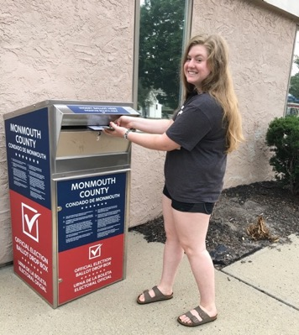
Turning the idea partisan
States (both red and blue) are turning to vote-by-mail to keep voters and poll workers safe during the Covid-19 crisis
Most Americans (Republicans and Democrats) support the change
But opponents, claiming potential for fraud, are turning the issue partisan
WHAT ARE THE FACTS?

Slide 33

We have lots of data
five states (CO. HI. OR, UT, WA)
In last two federal elections, about 1 in 4
Americans voted by mail
Five states (CO, HI, OR, UT, WA) use vote-by-mail primarily
28 other states (including NJ) allow
voting by mail without needing an excuse
Since 2000, >250 million votes were cast by mail
In 2018, > 31 million voters (25.8%) cast mail-in ballots
25.8% vote-by-mail
74.2% in-person voting
2018
Mid-Term Election
33

Slide 34

The track record:
No evidence that voting by mail significantly increases fraud
All five states (CO, HI, OR, UT, WA) using primarily mail-in voting have “essentially zero fraud”* under that system.
  Oregon: >100 million mail-in ballots since 2000; 12 cases of proven fraud (0.0000001%)
Investigation by journalists of all known voter fraud, 2000 to 2012: 492 vote-by-mail cases out of billions of ballots cast.
Americans more likely to be struck by lightning than commit mail voting fraud
* New York Times Editorial Board
34

Slide 35
Fraud, though rare, does happen
May 2020: Alleged fraud in Paterson NJ Municipal Election
“When someone tries an absentee ballot scheme like this clumsy attempt in Paterson, it is hard to hide. People get caught.”
Rick Hasen, Univ. Calif, Irvine, Law Professor
All vote-by-mail election, as pandemic precaution.
Irregularities reported. Under investigation.
2018: Blade County, NC
Fraud uncovered by postelection audit.
Political operative submitted absentee ballots that were not filled out by voters.
Election invalidated. New election held.
35

Slide 36
Vote-by-mail fraud great enough to swing an election is really hard to hide
Warning signs
Statistical outliers in voting totals
Signature mismatches
”Carrying an entire state election by mail ballot fraud would be nigh-impossible triumph of concealment in all but a harrowingly close contest.” Michael Wines, NYT 5/25/2020
36

Slide 37
Safeguards are in place
(and are getting stronger)
Identity verification
Bar codes
Secure drop-off locations
Harsh penalties
Post-election audits
Polling sites as back-up
37

Slide 38

Safeguards are in place
Bar codes
Mail-in ballot envelopes in New Jersey have unique bar codes
Bar codes track ballot processing and receipt—and eliminate duplicate ballots if a voter casts more than one
38

Slide 39
Safeguards are in place
Secure drop-off locations
For voters who can leave home, drop boxes limit opportunities for vote tampering
Ballot drop-off locations create a secure chain of custody from the voter to the election office
75% of vote-by-mail ballots in mostly vote-by-mail states are deposited in drop boxes
39

Slide 40

Safeguards are in place
Harsh penalties
Anyone who commits voter fraud using a mail ballot risks severe criminal and civil penalties
up to five years in prison and $10,000 in fines for each act of fraud under federal law, in addition to any state penalties.
40

Slide 41
Safeguards are in place
Post-election audits
Under construction
41

Slide 42
Safeguards are in place
Polling places as back-up
Under construction
sss
42

Slide 43

Does mail voting favor one party over the other?
Democratic Disadvantage
Republican Disadvantage
High mobility of poor and young (who tend Democratic) lead to mail-delivery challenges and problems matching registration records.
Ballot rejection rates vary greatly from county to county, based on enforcement practices. (Studies suggest higher rejection rates among the newly registered, young, females, and minorities—groups that lean Democratic)
Mail delivery in rural counties can be slow and can cause ballots to arrive to officials too late to be counted. Rural counties tend to lean Republican. (Study of 2020 Ohio primary: 1.7% mail ballots too late to be counted in large (predominantly Democratic) counties; 4.1% too late in rural (mostly Republican) counties.)
43

Slide 44

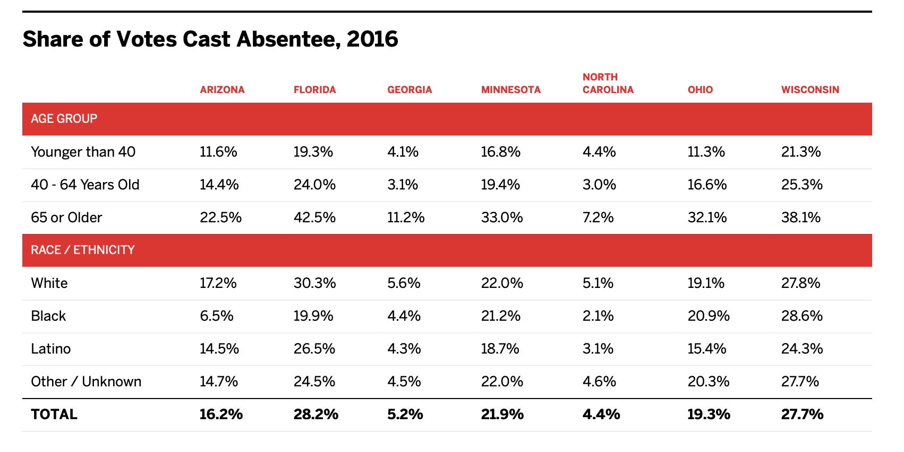
Who votes by mail?
In 2016, in these 7 no-excuse, battleground states:
Older, mostly white voters
Kevin Morris, “Who Votes by Mail?”, Brennan Center, April 15, 2020
44
Notes:
“Our analysis of these seven states makes clear that there is little reason to believe that mail voting would uniformly help Democrats in November. A report from the Pew Research Center found that voters over 65 and white voters supported Donald Trump over Hillary Clinton at the highest rates. Mail voting was used more frequently by older voters in the seven states we examined. footnote3_xjnmfe73 Additionally, in each state we studied, at least two-thirds of all mail ballots were cast by white voters. White voters had the highest rates of voting by mail in three of the seven states and the second highest rate in another three. Latino voters used mail options less than white voters in each of the swing states. In the outlier state, Ohio, all racial/ethnic groups but Latinos cast mail ballots at about the same rate. There, white voters used mail ballots two percentage points less often than Black voters, who had the highest usage rate.” Kevin Morris, “Who Votes by Mail?”, Brennan Center, April 15, 2020
We find that implementing universal VBM has no apparent effect on either the share of turned-out voters who are Democrats or the share of votes that go to Democratic candidates, on average, although these latter estimates are a bit less precise. We also find that it increases turnout by roughly 2%, on average—very similar to the estimate reported in ref. 4 for Washington State”. “Universal vote-by-mail has no impact on partisan turnout or vote share,” Proceedings of the National Academy of Sciences of the USA, June 23, 2020

Slide 45
The truth about voting by mail
Resources
Brennan Center
Michael Wines, “Which Party Would Benefit Most from Voting by Mail? It’s Complicated.,” New York Times, May 25, 2020. https://www.nytimes.com/2020/05/25/us/vote-by-mail-coronavirus.html
Daniel Thompson, Jennifer Wu, Jesse Yoder, and Andrew Hall, “Universal vote-by-mail has no impact on partisan turnout or vote share,” Proceedings of the National Academy of Sciences of the USA, June 23, 2020
45

