Slide 1


Fighting for the Vote
Notes:
As you are introducing yourself and the program, have a volunteer (League facilitator or student) hand out the avatar cards, one to each student.
Introduce yourself as a member of the League of Women Voters. Explain:
Non-partisanship
Roots—League emerged nearly 100 years ago from the fight for women’s right to vote.
Voter Service—League works to make sure that everyone who can vote does and that they have the information they need about the people running and the issues to cast an informed vote.
Explain reason for being here:
Here for one reason: To increase the likelihood that when you are eligible, you will vote—and even more, that starting now you will encourage your friends, family, and community to vote as well.

Slide 2
Why bother?
ELECTIONS
HAVE
CONSEQUENCES
Notes:
MODULE ONE INTRODUCTION
Here’s why it’s worth you time and our time to have this discussion: ELECTIONS HAVE CONSEQUENCES. Based on the outcome of elections and the people we have put in office, we have:
Allowed slavery--Outlawed slavery
Gone to war—Avoided war
Prohibited women from owning property
Drafted 18 year olds into the army
Imposed taxes—Given tax breaks
Closed our borders--Opened out borders
Outlawed abortion--Allowed abortion
Cleaned up dangerous chemicals in our air and water--Allowed dangerous chemicals to be poured into our air and water
Built parks
Closed schools—Opened schools
Funded and de-funded school arts and athletic programs
Changed school hours
Outlawed marijuana—Decriminalized and legalized marijuana
AND SO MUCH MORE THAT AFFECTS OUR LIVES AND THE VERY DEFINITIION OF WHO WE ARE

Slide 3

Module 1:
Suffrage Timeline
Notes:
MODULE ONE INTRODUCTION
DEFINE SUFFRAGE
Is this a familiar term? (Give a chance for students to answer)
If needed, explain it means “The right to vote”
Mention the similarity to “suffer”—a coincidence, since many suffered to get the right to vote
MAKE THE EMOTIONAL POINT: VOTING = POWER
The people who win elections make make the law. Voters decide who wins elections.
People without the vote are without power. Those in office do not listen to them. They paid attention to the voices and the needs of those who will keep them in office.
For this reason, from the birth of our nation, people have fought, gone to war, gone to jail, and died for the right to vote.
I’m going to ask you to open your minds and shift your perspective to see the world as they saw it.

Slide 4
What one thing do you care enough about to be willing to go to war or to prison for?
Notes:
SETTING THE STAGE
PRIVATE QUESTION
“Before we begin, please take out a pen or pencil and a piece of paper and write down your answer to a question.
It’s a personal question and no one else will see what you write. But even though your answer is private, the thought you put into it will influence how you hear what we’re going to be talking about.
So, please take 15 seconds to think about: ‘What one thing do you care enough about to be willing to go to war or to prison for?’
At the end of our time together, you can throw away the paper if you wish, or you may choose to keep it as a reminder of what you learned.”

Slide 5
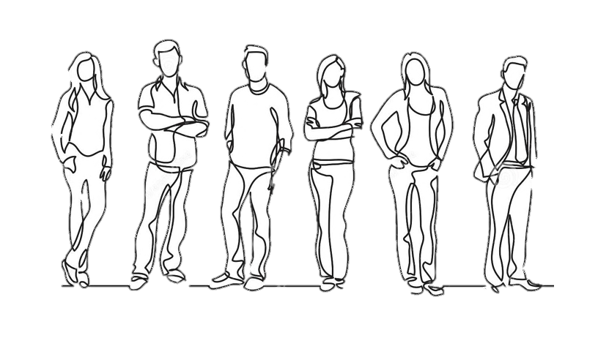
Who can vote?
Polling books
Notes:
“Let’s start with the basics. Who can vote?”
Ask students to offer requirements. Help them get to this list: citizen, at least 18 years old, not serving a prison sentence for a felony, on parole or on probation.
TRANSITION:
“This wasn’t always the list.
The requirement for voting used to be much different—in ways that are hard for us to imagine today.
But that’s exactly what we’re going to do—imagine what it was like for white men, for African Americans, for women, for young people, and for Native Americans who wanted to vote over the first 200 years of our history.”

Slide 6
Building the Suffrage Timeline
Notes:
PREPARATION FOR THE “Fighting for the Vote” Role Play
Explain that they are going to help tell the story of suffrage—the fight for the vote.
Call their attention to the avatar cards, explaining that for the purpose of the story, they are going to be the PERSON ON THEIR CARD.
Explain:
You may be taking the identity of someone who is not like you—you may play a female if you are a male or the other way around. That’s okay.
Take 15 seconds to think about what it would be like to be your avatar—the people on your card. Imagine BEING THEM. How it would feel. How it would be different from what you know and experience.
For the purpose of what we are about to do, you are going be this person and feel and think what they would feel.
Ask one or two students to tell us who they “are.”

Slide 7
The Revolutionary War
Notes:
“Americans have been fighting for the vote from the beginning of our nation.
We fought a war with England—the Revolutionary War—for our independence. One way to look at the Revolutionary War is to think about it as a fight for the right to VOTE.
The colonists were upset because—among other things— they were being taxed by the English Parliament and they had no voice (vote) to select the members of Parliament.
Remember the famous protest: ‘Taxation without representation”
Or those angry Colonists throwing tea in Boston Harbor.
Make the point that people died:
“In the Revolutionary War, this war for the right to vote, nearly 17,000 Colonists died in action
Between 8,000 and 12,000 Colonists were taken prisoner—many thousands of these prisoners of war died of disease.”

Slide 8
What did the founders decide about voting?
Notes:
Having won the war, the leaders of the new nation met, argued, and finally agreed on the rules under which the government would operate. They set these rules down as the U.S. Constitution.
“Many leaders of the new nation opposed creating a strong central government. After all, they had just gotten rid of King George III. They argued that the balance of power should favor the new states, not the federal government.
And when it came to the debate over who could vote, these anti-federalists won the day. The founders decided:
NOT TO DEFINE VOTING REQUIREMENTS AT THE FEDERAL LEVEL
.
THEY GAVE THAT RESPONSIBILITY TO THE STATES.”

Slide 9
It’s 1789. Who can vote?
Notes:
WHO CAN VOTE?
Ask “What do you think the states decided?” Write correct guesses on the easel chart and get to the full list.
Ask: “Who was left out and why?” [Touch on attitudes toward women, Native Americans, and African Americans.]
VISUAL TIMELINE
Invite students to participate: “It’s 1789, more than 200 years ago. Look at your avatar card and STAND UP and come to the front if you can vote.
Give the “Revolutionary War” Milestone Card to one of the “voters” to hold.
Ask a few of those sitting who they are and why they cannot vote. Ask why people of color could not vote—look for BOTH reasons (not white, not citizens).

Slide 10

1856
End of Property Requirements
Notes:
Let’s move ahead 60 or so years, to 1856. By this year, the last state (North Carolina) gave up the property requirement as a condition for voting.”
Ask: “Why do you think the states extended voting rights to men without property?” Engage students in possibilities. See if they suggest “fairness.”
Explain:
“It’s tempting to think that the states had decided that the property requirement wasn’t FAIR because it meant that poor people had no vote and no voice.
More realistically, it was probably because the politicians in power believed that the new voters were likely to vote for their party.
Whatever the reason, by 1856, the property requirement was gone across the country.”

Slide 11
It’s 1856. Who can vote?
Notes:
WHO CAN VOTE?
“Where does this leave us? Across the county, election laws allowed WHITE MEN, 21 YEARS OLD AND OLDER, who were CITIZENS to vote.”∗
Return to the easel sheet and cross out “PROPERTY OWNER”

Slide 12
The Civil War
Notes:
The right to vote is not mentioned in the Constitution.
It was not until the end of the Civil War that the Constitution was amended to set the first nation-wide rules about suffrage.
Here’s what happened:
About the same time the states were eliminating property ownership as a voting requirement, the country was facing the biggest challenge in our history—one that would have a profound effect on suffrage.
In the mid 1800s, tensions between the North and South were mounting over the question of slavery—the question of whether new states when they entered the Union would be free- or slave- states.
The election of Abraham Lincoln brought the tensions to a head. The South withdrew from the Union and hostilities began. Between 1861 and 1865, America waged the bloodiest war in our history—the Civil War.

Slide 13
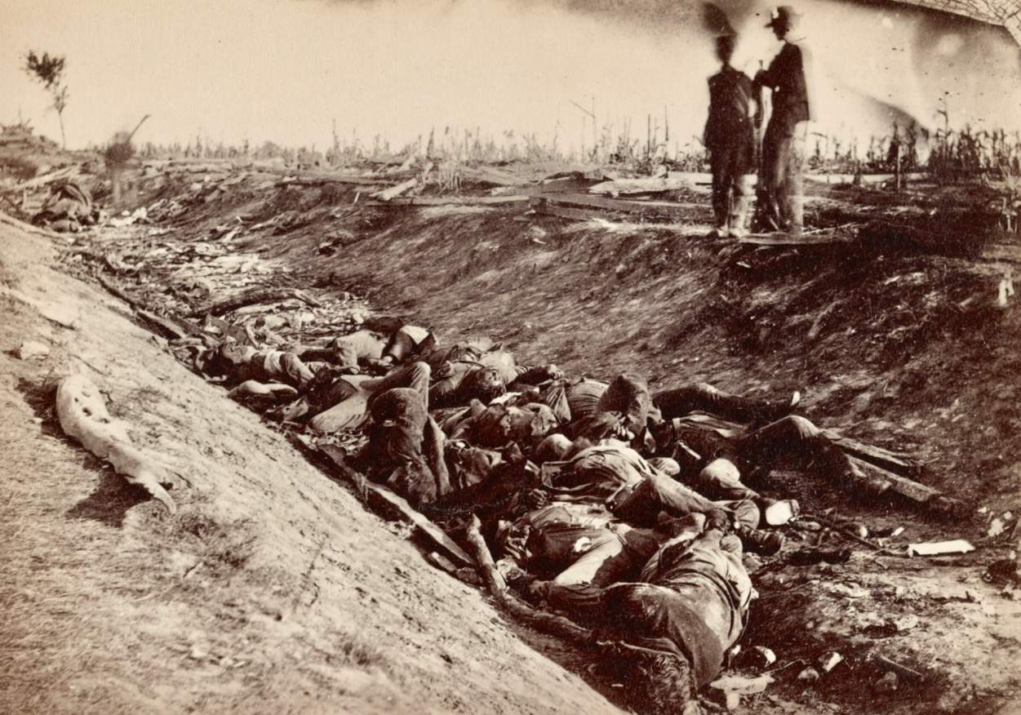
~750,000 Americans died
(2% of population: 6 million today)
Notes:
The war was fought at first indirectly and ultimately directly over slavery and the rights of African/Black Americans. But in the end, it was also about suffrage. The North won the war. The Union was saved, slavery ended, and African American males were given the vote.
“The country paid a very deadly price for these gains:
Between 650,000 and 850,00 Americans died as a result of the war, more than in any war we’ve fought
620,000 Americans equaled 2% of the nation’s population in 1860, the equivalent of losing 6 million Americans today
1 in every 4 soldiers who went to war did not come home.

Slide 14
For the first time
The federal government steps in.
Notes:
In 1865, at the end of the Civil War, the 13th Amendment to the Constitution passed. It ends slavery.
In 1868, the 14th Amendment made all people born in the U.S. (including former slaves) American citizens.
And two years later, in 1870, the 15th Amendment changed the suffrage laws across the country. It gives African Americans the vote.
It states that:
“The right of citizens … to vote shall not be denied … by the United States or by any state on account of race, color, or previous condition of servitude.”

Slide 15
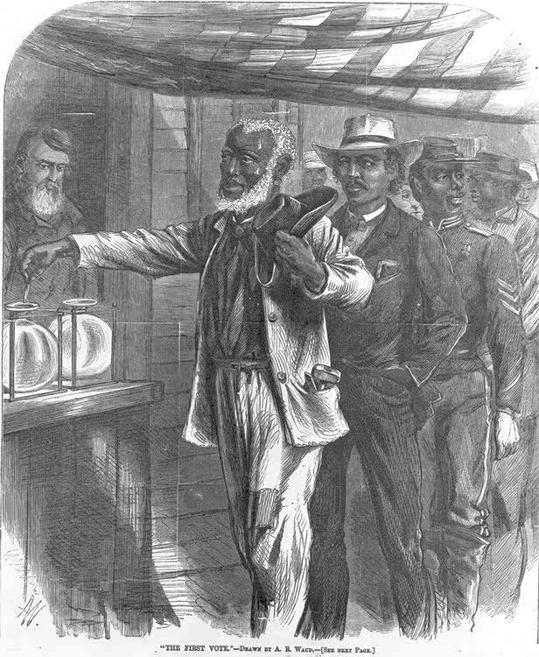
It’s 1870. Who can vote?
Thomas Mundy Peterson
Paterson, New Jersey
Notes:
WHO CAN VOTE?
Where does this leave us? Across the county, election laws allowed MEN, 21 YEARS OLD AND OLDER, who were CITIZENS to vote.
Return to the easel sheet and cross out “WHITE.”

Slide 16

1920
19th Amendment
Notes:
It is now 1920.
It’s been more than 130 years since men were given the vote.
It’s been 50 years since African-American men were given the vote.
But still, with the exception of some states in the west, women could not vote.
By the mid-1800s, women were losing their patience. Many had been politically active as abolitionists, fighting to end slavery. Many were leaders in the political campaign to outlaw alcohol. They ‘found their voice’ and experienced their political power. In 1848, they began to organize for the vote.
These women were called SUFFRAGISTS—Susan B. Anthony was among the most famous.
They marched, gave speeches, held protests, lobbied politicians.
The suffragists’ fight for the vote took more than 70 years. And Susan B. Anthony and the first wave of suffragists did not live to see it happen.”

Slide 17
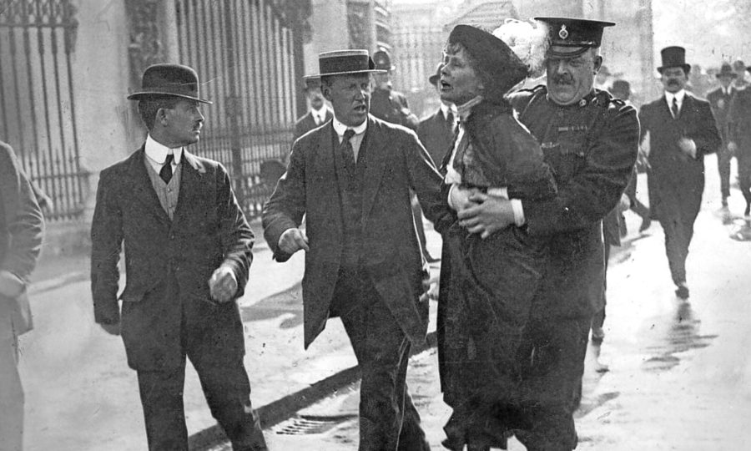
Notes:
Show the poster.
In the early 1900s, a new generation of women took up the fight.
These suffragists were even more aggressive.
They travelled the country and campaigned state by state to convince legislators to change state laws.
They also pressured the members of Congress and the President of the United States to propose a Constitutional Amendment. The 15th Amendment has overridden state authority to say that the states could not deny citizens the right to vote based on RACE. The suffragists want a Constitutional Amendment to say the states could not deny citizens the right to vote based on SEX.
These suffragists were unstoppable.
They marched. They sued. They lobbied.
They picketed outside the White House for more than a year—through rain, cold, and blizzards. They were harassed—even by other women, most of whom did not want the vote.
When the President lost his patience with their picketing, they were arrested.

Slide 18
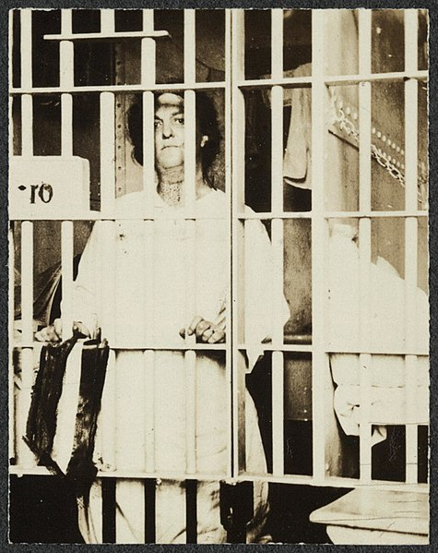
Notes:
Show the poster or slide of the suffragist behind bars.
Some suffragists who were arrested refused to eat—they went on hunger strikes.
They wanted people to know that they were willing to DIE to get the vote
.
They were force fed, a painful process where a tube was forced down their throat or through their nose and food was poured into their stomachs.

Slide 19
It’s 1920. Who can vote?
Notes:
WHO CAN VOTE?
Where does this leave us? Across the county, election laws allowed CITIZENS WHO ARE 21 YEARS OLD AND OLDER.
Return to the easel sheet and cross out “MEN.”

Slide 20
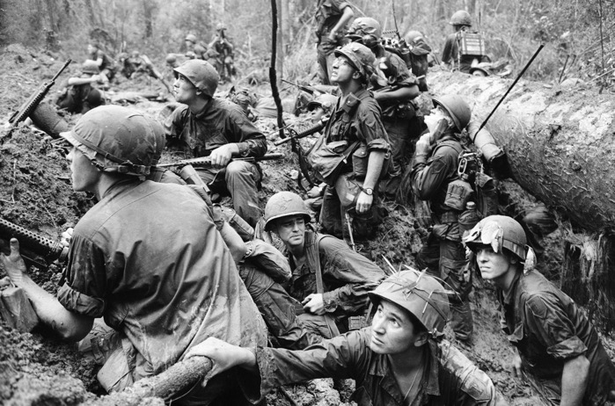
1971
26th Amendment
Notes:
Explain that the last change we made to the Constitution about suffrage happened in 1971, when the 26th Amendment to the Constitution lowered the voting age to 18.
We’ve just seen that fight for the vote in two of the three cases we’ve covered involved war—The Revolution and the Civil War. The 26th amendment indirectly involved war, as well. Here’s the background.
The 1960s were a decade of unrest and protest in this country. Much of the protest was against the Vietnam War. Many Americans, especially the young, wanted to end our involvement.
At the time, the country had a draft—18-year-old men had to register with the government and from that pool the Army and other branches of the military drew names of men who had to serve. In the 1960s, tens of thousands of these young men went to war in Vietnam.
More than half the American servicemen killed in Vietnam were between 18 and 20 years old.
The protesters asked: “If we are old enough to die for our country, how can it be that we are not old enough to vote?” They chanted ‘Old enough to fight, old enough to vote.’”

Slide 21
It’s 1971. Who can vote?
Notes:
WHO CAN VOTE?
The 26th AMENDMENT to the CONSTITUTION guarantees that “The right of citizens of the United States, who are 18 years of age or older, to vote, shall not be denied or abridged by the United States or any state on account of age.”
Return to the easel sheet and cross out “21” and write in “18.”
18

Slide 22
Timeline
1920
White
Men
Property owners
At least 21 years old
Citizen
1870
1971
1856
White
Men
Property owners
At least 21 years old
Citizen
18
1789
Notes:
WRAP UP THE TIMELINE
The suffrage timeline is complete.
Quickly read each Milestone Card and remind the class what happened at that point in the suffrage timeline.
Thank the standing students for their help, collect their milestone and avatar cards, and invite them to sit down. Collect the avatar cards from those still in their chairs.

Slide 23

There’s more to the story . . .
Notes:
“We’ve seen how the state laws and the Constitution itself have changed over two centuries to remove barriers to voting—to include the poor, African-Americans, women, and young adults. But there is more to the story.
“Despite the trend toward greater suffrage, there has been a consistent push in the other direction. Throughout our history, there has been powerful resistance to allowing certain groups to cast their votes—even when the law has given them this right.“
Over the years, Native Americans, citizens of Asian descent, felons and former felons have been denied the vote. One by one, at the state and at the federal level, things have improved.”
“So even though we’ve worked through major milestones in the Fight for the Vote, we’re not done. There are setbacks and breakthroughs we need to talk about.”

Slide 24
Voting Rights Act
1965
Notes:
“The first setback we need to explore happened after the Civil War—in response to the 15th Amendment that gave African Americans the right to vote.”
“The Constitution said that African Americans could vote—but there were places in the country where people went to extreme lengths to ensure they did not.
“In the South, after the Civil War, local and state laws were passed that kept the races separate and did everything possible to prevent black citizens from voting.
They were called JIM CROW LAWS.
Punishment for defying Jim Crow laws was severe. Into the 20th century, men were lynched (hanged) for trying to vote. Obstacles were put in the way: literacy tests, property requirements removing the names of blacks from the list of voters for made-up reasons, preventing anyone who had served time in prison from voting, making people pay a tax to vote.”
Remember we talked about the social upheaval of the 1960s that led to the 26th Amendment lowering the voting age. That upheaval included a national movement to end Jim Crow—the address the unfair treatment of African Americans, including denying the right to vote.
Civil Rights and Voting Rights champions emerged. Martin Luther King advocated nonviolent resistance. Under his leadership and inspiration, blacks and whites marched, demonstrated, held sit-ins, and risked their lives to stand for African American rights.”

Slide 25
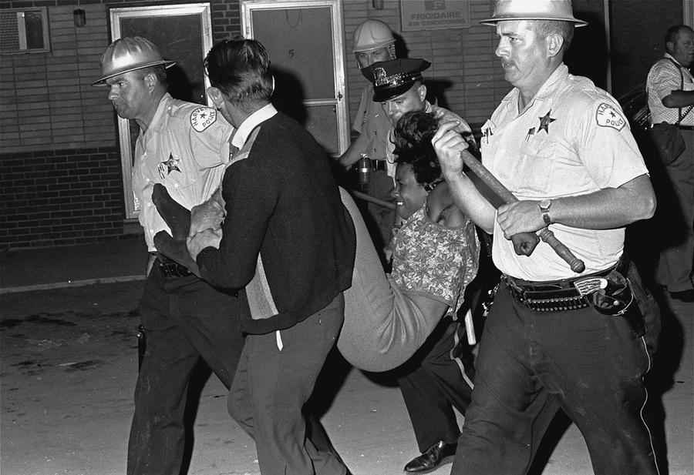
Notes:
Show the poster of the voting rights protester being arrested.
The civil and voting rights activists in the South were beaten, arrested, and some were killed. Martin Luther King was assassinated. A man was murdered for registering black voters. Four young girls were killed when the church they attended, which was a center for civil and voting rights meetings, was bombed. Dozens of activists were shot.
But the activists continued to march and demonstrate. On the Selma to Montgomery march for voting rights in 1965, state troopers attacked marchers with nightsticks, tear gas, and whips. The violence was shown on national television and helped shock the nation and move the President to act.
“In response, on August 6, 1965, President Lyndon Johnson signed the VOTING RIGHTS ACT into law.
The Voting Rights Act, though not an Amendment, was a federal law that outlawed unfair voting practices nationwide.
It gave the federal government the right to look into elections where the voting rights of the non-white population appeared to be denied and gave African-American voters the legal means to challenge voting restrictions.”∗

Slide 26

Voter suppression continues
Partisan redistricting
Long lines
Disciminatory ID laws
Wrongful voter purges
Notes:
Unfortunately, even the Voting Rights Act did not end efforts to make it difficult or impossible for certain groups (particularly African Americans) to vote.
Some states today are trying to put laws in place to discourage voting. They are imposing voter identification requirements at the polls, they are eliminating voting places making for long lines and long waits to vote, they are requiring street addresses on voter registration form for Native Americans on reservations where there are no street addresses, and more.
The League of Women Voters is among the organizations fighting these practices.”
In 2013, the Supreme Court overturned an important part of the 1965 Voting Rights Act, opening the door to the return of voter suppression practices in some states (cutting back early voting, restricting private groups from conducting voter-registration drives, eliminating election-day voter registration, imposing strict voter ID rules, etc.).

Slide 27
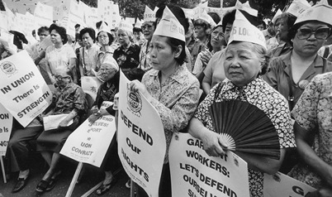
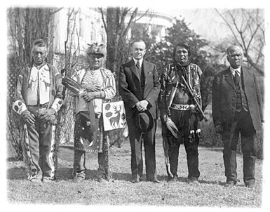
Expanding suffrage
Asian Americans
1952
Native Americans
1957
Felons/former felons
Notes:
Citizenship for Asian American
Before we move on, we need to at least acknowledge that is hasn’t been only African Americans, women, and the young would were deprived of the vote.
In 1882, a law was passed forbidding people of Chinese ancestry who moved to the United States to become U.S. citizens. In the 1920s, the Supreme Court ruled that people of Japanese or Asian Indian descent who moved to the United States could not become naturalized citizens.
These rules stayed in place until 1952 when Congress passed a law granting all people of Asian descent to become citizens.
Citizenship for Native Americans
The Native American tribes were considered separate nations. Native Americans were not considered citizens and therefore could not vote. In 1924, a law passed making Native Americans born in the United States citizens. Even after 1924, there were states where Native Americans could not vote.
It was 1957 before all the states allowed Native Americans to vote.
Voting rights for felons and former felons
Over the years, all but two states (Maine and Vermont) have taken voting rights away from people who are serving in prison on a felony charge. Some states refuse to restore voting rights even after former felons have served their time and completed parole and probation. This means that nearly 4 million U.S. citizens, disproportionately African American, lose their right to vote for life because of a past felony
IN NEW JERSEY, former felons who have served their sentence, parole, and probation are ELIGIBLE TO VOTE, BUT THEY MUST RE-REGISTER. The League of Women Voters is active in re-registering former felons.”

Slide 28
What one thing do you care enough about to be willing to go to war or to prison for?
Notes:
DE-BRIEF THE TIMELINE ROLE-PLAY
Ask the students to take a few seconds to look at the answer they wrote down at the start of the lesson to the question “What would you be willing to go to jail for? To go to war for?”
Restate that throughout our history, the answer for thousands has been “THE RIGHT TO VOTE.”

Slide 29
Voting is a hard-fought-for right.
Who is using the power of the vote?
Notes:
TRANSITION TO MODULE 2
Ask: “Voting is a hard-fought-for right. Who is using its power?

Slide 30
Module 2:
Voter turnout
Notes:
So far, we’ve seen all that was sacrificed and done so that we can vote. The interesting question is: “Are people taking advantage of this hard-won right to vote?”
Go to next slide

Slide 31
What percentage of people who were eligible to vote actually voted in the last election (nationwide)?
Notes:
Leave the question exposed but not the pie graph
Ask students to write on their paper the percentage of eligible voters (those who are citizens and over 18 whether or not they are registered) they think voted in the 2018 election.
Ask for hands: How many wrote over 50% Under 50% Exactly 50%
Click to reveal the pie graph showing 50% of the population voting (prize awarded to anyone who wrote 50%)
Ask: “Are you surprised?” “Does it worry you that such a small part of the population is making decisions for all of us?”
Go to next slide

Slide 32
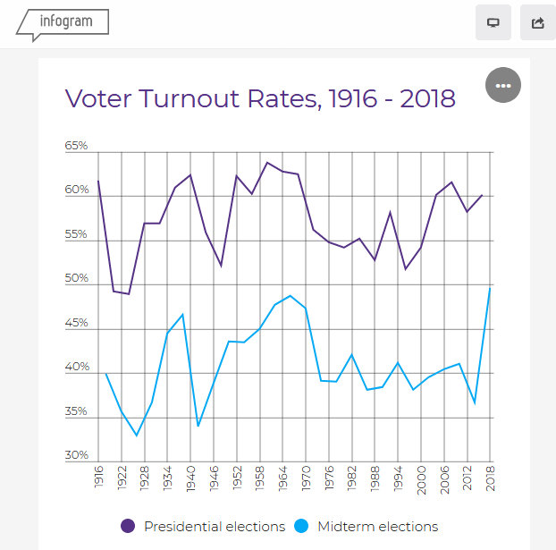
National estimates of voter turnout expressed as a percentage of the voting eligible population.
Source: United States Elections Project www.electproject.org)
GOOD
Notes:
Explain what they are looking at
Total voter turnout
About 100 years of elections (1916 – 2018)
Purple line shows percent of turnout in Presidential elections
Blue line shows percent of voter turnout in mid-term elections (when we elect Congress, but not a President)
Divide an easel chart vertically. At top of one column write “data” and at the top of the other column “assumption”
Ask what the data says: “What do you notice about the two lines?” [sample answers]
1) big difference between turnout for Presidential and non-Presidential elections
2) No overall improvement to speak of over 100 years
3) varies a lot from election to election
Ask them to look at 2018 and compare to the past: “What percentage of people actually voted in the last election?” 50% the highest ever in 100 years for a mid-term.
If time, ask if they can make some assumptions about what the increased voter turnout.
Go to next slide

Slide 33
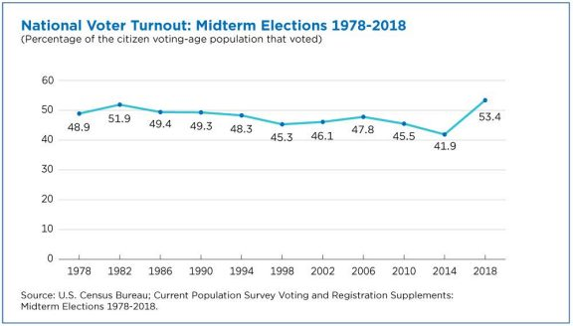

Slide 34

So…
Who has the power of the vote?
Notes:
Read the slide
Say: “Let’s break it down a bit”
Go to next slide

Slide 35
VOTER TURNOUT BY AGE (18-29 years old) –
PRESIDENTIAL AND MID-TERM ELECTIONS
GOOD
Notes:
Explain what they are looking at
Total voter turnout among people in your age group (18-29) only
Presidential elections only
1996-2016 – the years most of you have been on this earth
Ask: “What does the line tell you about voter turnout among people in your age group?”
Ask one or two students to respond (DO NOT CHART YET)
Pausing only for a moment, then
Go to next slide

Slide 36
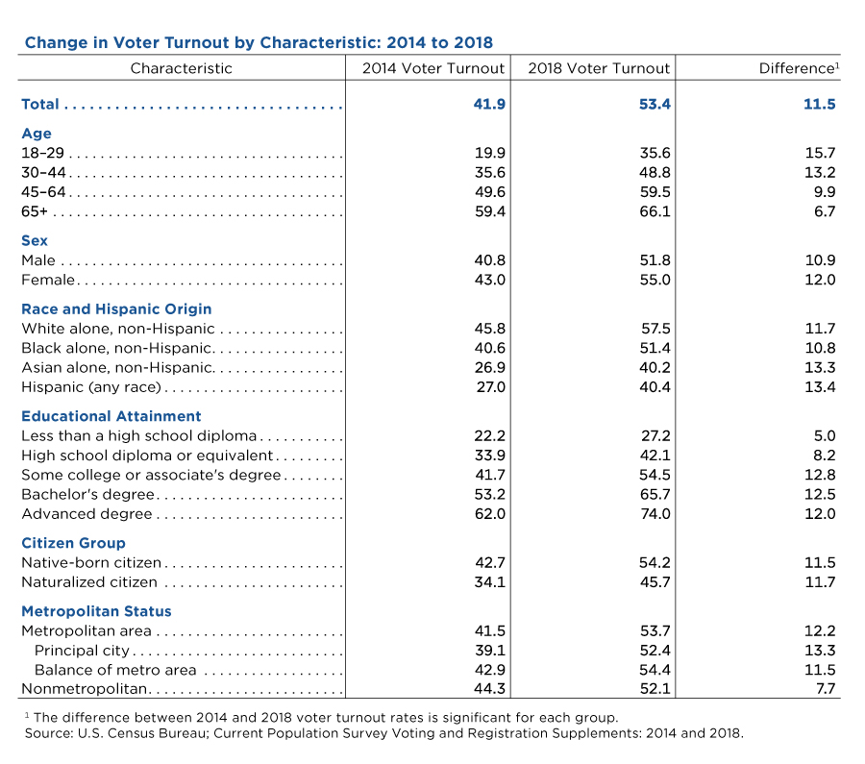

Slide 37

VOTER TURNOUT BY AGE – PRESIDENTIAL ELECTIONS
Notes:
say: “This slide adds voter turnout among people 30-44 years of age.”
Go to next slide

Slide 38
VOTER TURNOUT BY AGE – PRESIDENTIAL ELECTIONS
Notes:
Say: “This slide adds voter turnout among people 45-59 years of age.”
Go to the next slide

Slide 39
VOTER TURNOUT BY AGE – PRESIDENTIAL ELECTIONS
Notes:
Say: “This slide adds voter turnout among people 60+ years of age.”
Say: “I’m going to give you about 15 seconds to stop and jot something you can add to our data/assumptions in a few minutes when we work in small groups.

Slide 40
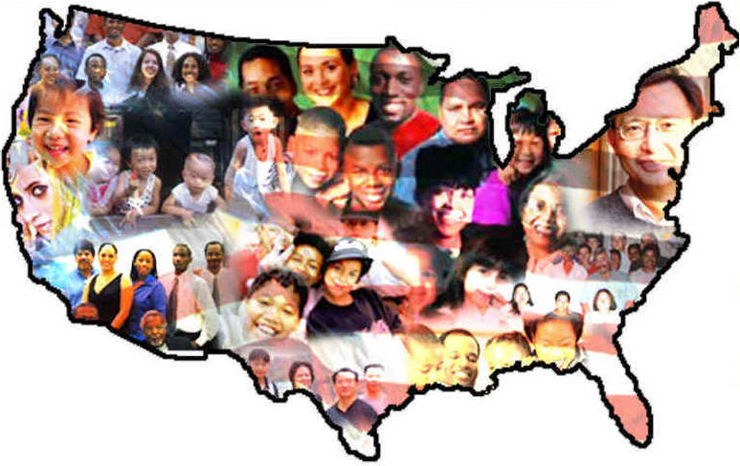
Do you think voter turnout varies by race/ethnicity?
Notes:
Read the first question on the slide.
Ask students to give you a thumbs up/thumbs down – up if they think it does vary by race; down if they think it doesn’t
FYI – if students ask who “other” includes: (The most recent United States Census officially recognized five racial categories (White American, Black or African American, Native American and Alaska Native, Asian American, and Native Hawaiian and Other Pacific Islander) as well as people of two or more races. The Census Bureau also classified respondents as "Hispanic or Latino" or "Not Hispanic or Latino", identifying Hispanic and Latino as an ethnicity (not a race), which comprises the largest minority group in the nation.

Slide 41
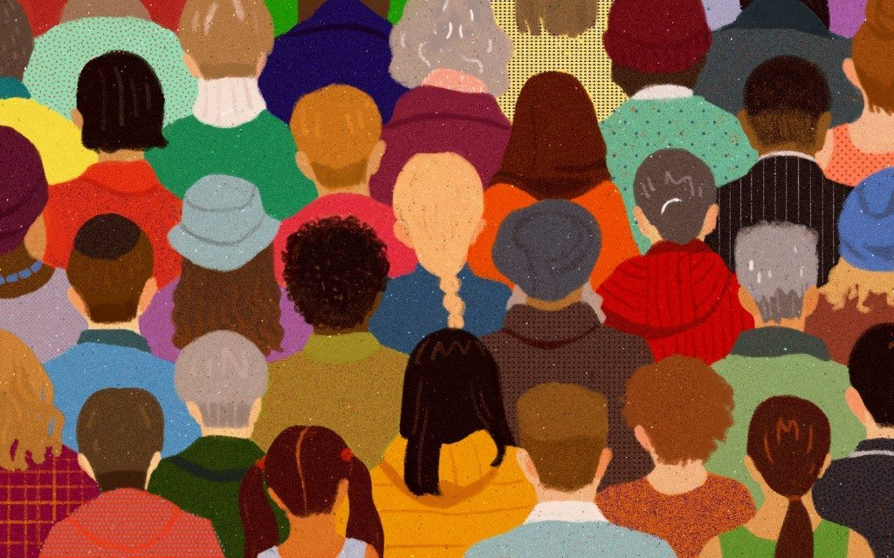
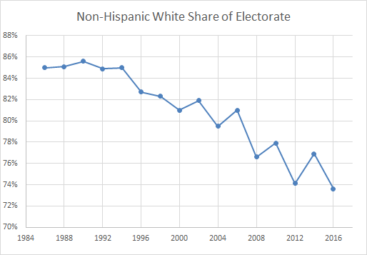
Non-Hispanic White Share of Electorate
Notes:
Say: “ The voting population in the United States originally was all white, land-owning men. We saw that voting population change over time in our avatar game. That change means, of course, that our electorate has become more representative of our actual adult population over time. It also means that the percentage of white voters has been decreasing in terms of the share of voting power they have to affect the laws and policies in our communities and nation.”
Explain what they are looking at
Total percentage of white share of the electorate
Presidential and mid-term elections
1984-2016 – about 30 years
Observe:
In 1986, the white share of the electorate was 85% (15% was non-white)
In 2016, the white share of the electorate was 73% (27% was non-white)
Ask: “What does the line tell you about the trend in our national electorate?”
Ask one or two students to respond
Go to next slide

Slide 42
GOOD
Notes:
Explain what they are looking at
Total voter turnout among people who are non-Hispanic whites only (all ages)
Presidential elections only
1992-2016 – the years most of you have been on this earth
Ask: “What does the line tell you about voter turnout among whites?”
Ask one or two students to respond (DO NOT CHART YET)
Pausing only for a moment, then
Go to next slide

Slide 43
GOOD
Notes:
say: “This slide adds voter turnout among people who are non-Hispanic blacks.”
Go to next slide

Slide 44
GOOD
Notes:
say: “This slide adds voter turnout among Hispanic voters.”
Go to next slide

Slide 45
GOOD
Notes:
say: “This slide adds voter turnout among other racial and ethnic groups”
Say: “I’m going to give you about 15 seconds to stop and jot something you can add to our data/assumptions when we break into small groups
Go to next slide

Slide 46
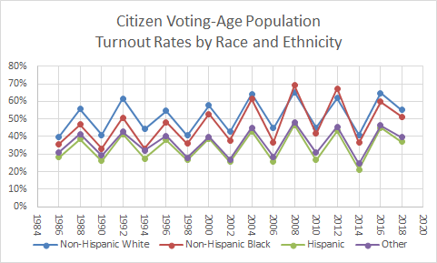

Slide 47

Do you think voter turnout varies by level of
Notes:
Go to next slide

Slide 48
GOOD
Notes:
Explain what they are looking at
Total voter turnout among people with less than a high school diploma
Presidential elections only
1988-2016 – 30 years
Ask: “What does the line tell you about voter turnout among people who don’t have a high school diploma or GED?”
Ask one or two students to respond (DO NOT CHART YET)
Pausing only for a moment, then
Go to next slide

Slide 49
GOOD
Notes:
Explain what they are looking at
Say: “This slide adds voters who turned out who are high school grads
Go to next slide

Slide 50
GOOD
Notes:
Explain what they are looking at
Say: This slide adds those who have some college education through to college grads
Go to next slide

Slide 51
GOOD
Notes:
Explain what they are looking at
Say: “And finally, this slide adds those voters who have a post-graduate degree”
Say: “I’m going to give you about 15 seconds to stop and jot something you can add to our data/assumptions when we break into small groups
Turn and Talk: Say: “ You will have two minutes to turn to the person next to you. Share your statements about each of the sets of charts with each other and then together, create a statement of one or more assumptions which the data suggests. Write them down.”
Walk around to be sure everyone is engaged (give a private nudge if someone seems unengaged.) When pairs are finished, or at the end of 2 minutes at the most, call on several groups at random and chart the facts evident from each set of charts.
Move to next slide.

Slide 52
So, who is making the decisions?
Turns out that historically,
the older you are
the whiter you are and
the more education you have
The more likely it is that you will vote

Slide 53
Voter turnout
Turns out
To be a big deal
Notes:
Bring home the message:
Say:
“Historically, the older, the white, and the more education you have been able to obtain, the more likely you are to vote.”
Even in the highest turnout group (like my group,) more than ¼ of the people eligible to vote choose not to.
Among the young (people 18-29 who are in the room,) the record is awful. More than ½ of those who are eligible to vote choose not to.
Next slide

Slide 54
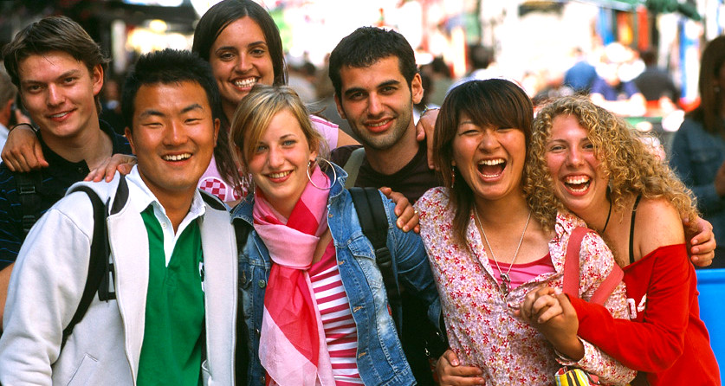
If you want politicians to make the decisions you want them to make
You have to get involved.
You have to elect people who look like you
and who reflect your values.

Slide 55


IS THERE

Slide 56
Increases in voter participation
from 2014 midterm to 2018 midterm
-------------
Among 18- to 29-year-olds, voter turnout went from 20 % in 2014 to 36 % in 2018, the largest percentage point increase for any age group — a 79 % jump.
By ethnicity
Blacks 40.6% to 51.4% increase of 10.8%
Hispanics 27.0% to 40.4 increase of 13.4%
Other 26.9% to 40.2% increase of 13.3%
White 45.8% to 57.5% increase of 11.7%
By educational attainment
< high school 22.2% to 27.2% increase 5.0%
High school 33.9% to 42.1% increase 8.2%
Some college 41.7% to 54.5% increase 12.8%
Bachelor’s degree 53.2% to 65.7% increase 12.5%
Advanced degree 62.0% to 74.0% increase 12.0%

Slide 57
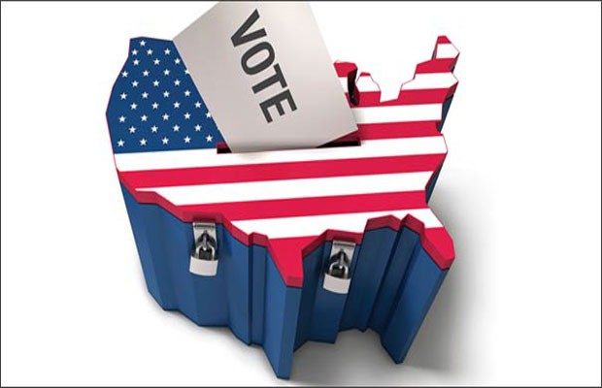
Can we CONTINUE to increase the number of people, who have not traditionally voted, to get to the polls?
Notes:
Ask pairs of students to join another pair for the next activity. Tell the students they wil now contribute to our understanding of ways we can GOTV.
Ask students: “If you were in charge, what would you do or what would you change to get people out to vote?”
Allow 2-3 minutes (judge by conversation when to stop, but definitely by 3 minute mark.)
Randomly call on groups to capture as many ideas as possible on a new flip chart. Summarize the themes.
Next slide.

Slide 58
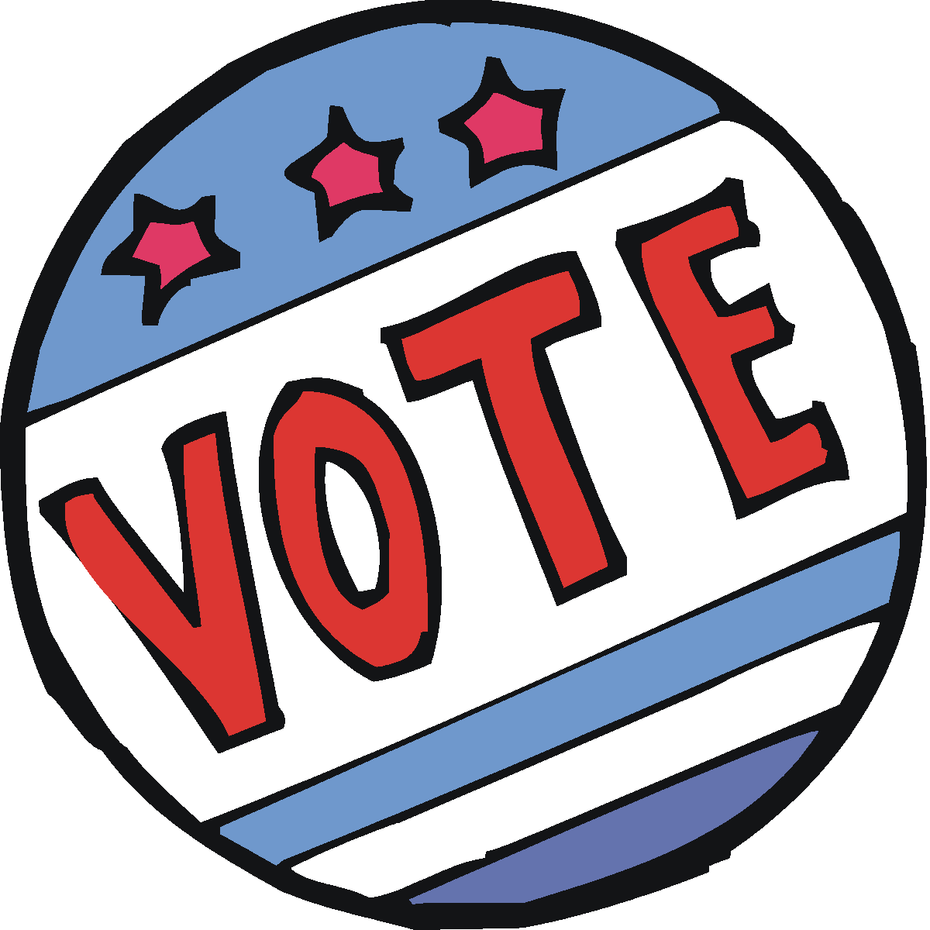

Why don’t
some people
Notes:
Say: “Take 1 minute to turn and talk. Brainstorm as many reasons as you can think of to answer this question about your own age group.”
Record on a new flip chart, randomly calling several groups in the room. Put a check mark by any duplicate answers. Ask: “Does anyone have another idea that hasn’t been boarded?” Draw any conclusions that pop out from the list.
Next slide.

Slide 59

How will you answer someone who asks:
SHOULD I VOTE?
Notes:
State your “vote of confidence” that everyone in the room will vote in the coming year if they are eligible.
Jump to wrap up if not doing Module 3.
The LWV will work separately from this session with the school to arrange voter registration drives.
We’ve gone through the Fight for the Vote, we’ve looked at the challenge of voter turnout, [and, if Module 3 was used, we’ve walked through what it’s like to vote in person.]
Say: “If someone asks you why they should vote, what would you answer?” Discuss responses and encourage the students to advocate for vote. If time, say, “Let’s practice,” and do a few role playing situations. Use the reasons students gave for why people their age don’t vote as the scenarios for the role play.
Next slide.

Slide 60
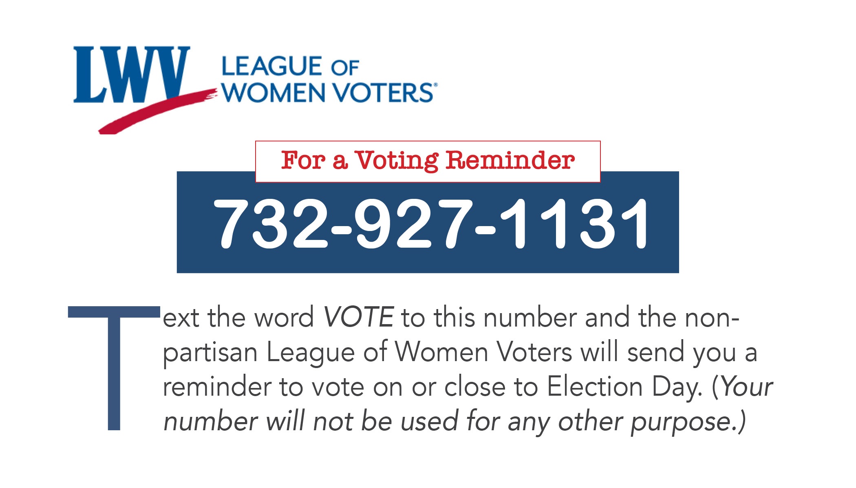
Notes:
Share voter support tools:
Hand out Voting Reminder/VOTE411 cards and explain those who are, or who intend to register to vote when able, can text the word VOTE to the non-partisan LWV. (Info will be used ONLY for sending a reminder to vote prior to the elections.) If time, give students the opportunity to so while in the room.
Point out that the VOTE411 (on other side of card) has voter information tailored to you. You enter your address and see what will be on your ballot, where to go to vote, polling hours, and more. It also has a hotline to call if you have any trouble voting.
Ask students to make a commitment. Have them write down one thing they will personally do to increase voter turnout.
Have voter registration forms available to pass out to anyone who needs them for themselves, friends, or family members.
Hand out Fighting for the Vote wrist bands while thanking students for participating. Express your optimism for the future if they choose to vote.

Slide 61
Module 3:
How to Vote
Notes:
The first time someone goes to the polls, the experience can be intimidating – new places, new faces, new routines to learn. We are sharing the following in hopes that it will reduce whatever anxiety might surround voting and help make it an exciting milestone in a person’s life.

Slide 62
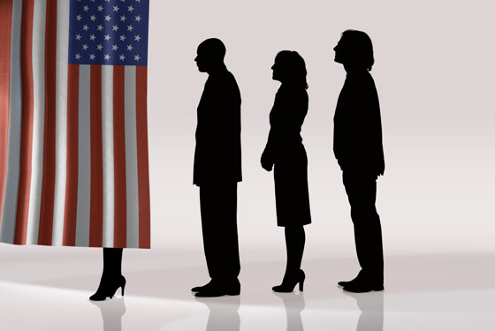
The voting experience
Who
What
When
Where
How
Notes:
Acknowledge that voting can be confusing, even intimidating, for first time voters. Take a few minutes to talk about what to expect. “Let’s answer the basic questions: Who? What? When? Where? and How?
WHO
WHAT
WHEN
WHERE
HOW
If not using slides, write the questions on a flipchart. Point to the appropriate question as you proceed through the discussion.

Slide 63
Who?
Registered voters
Who actually cast a ballot!
Polling books
Notes:
“Who votes?” (Animated slide)
Slide shows just “Registered voters”
We’ve just reviewed the requirement for registering. The answer is ‘Those who have registered.’
CLICK—Slide reveals voting options
But that’s not the complete answer. Registered voters stay home in large numbers. It’s not enough to register. You need to show up at the polls!

Slide 64
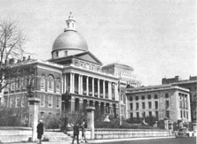
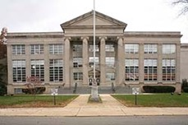
What?
National
State
County
Local
Polling books
Notes:
Animated slide. Each click reveals another level of office
“What are we voting for?” Explain:
“You are voting for candidates for public office—at the national, state, county, and local levels.” Ask students to name offices at each level—fill in with answers, as needed. “At the national level, you vote for President, Vice President, U.S. Senators, and members of the House of Representatives (Congressmen and Congresswomen). CLICK At the state level, you vote for Governor, Lt. Governor, State Senators, and State Assemblypeople. CLICK At the county level, you vote for Freeholders, the Sheriff, and other county-level jobs. ∗ And CLICK at the local level, you vote for the people who govern your town, oversee the schools, and direct the fire department.”
“You sometimes are asked to vote on public questions, also called ballot issues. For example, a ballot issue might be ‘Do you support adding to the tax rate to raise the money to preserve open space?’”
∗ County offices include Freeholder, Sheriff, Clerk, and Surrogate.

Slide 65
When?
Primary Elections
General Elections
As scheduled
Special Elections
Polling books
Notes:
Animated slide. Each click reveals another type of election
“When do we vote?” Explain:
“In general, we vote in primaries, general elections, and special elections.”
“Primaries are elections where the major political parties—the Republicans and the Democrats—choose the candidates who will run in the general election. New Jersey holds its primaries in June. This year, June 4. To vote in a primary, you have to “declare” whether you are a Democrat or Republican. You can do this when you register—or, if you have never declared officially, you can go to the polls on primary day and declare your party to the poll worker. If you are a Democrat, you will vote in the Democratic primary. If you are a Republican, you’ll vote in the Republican primary.”
CLICK “General elections are held in November to elect national, state, county, and usually local candidates. You can vote for any candidate—independent of your party affiliation.”
CLICK “Special elections are held different times in the year. They might include school board elections, non-partisan town elections, elections to fill unexpired terms, and more.”

Slide 66
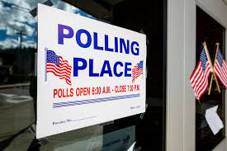
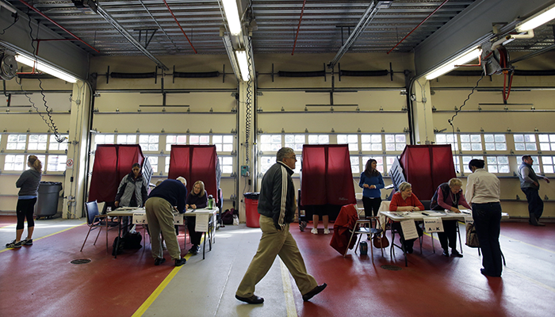
Where?
Polling books
Notes:
“Where do we vote?” Explain:
“On election day, there are polling places set up in your town where you will go to vote. If you are registered and you will be 18 by election day, you will receive a sample ballot in the mail telling you where to go to vote—your polling place. “

Slide 67
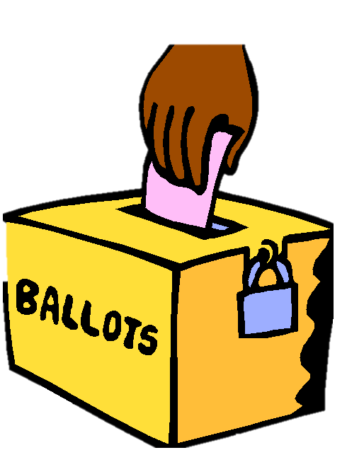

How?
In person
By mail
Polling books
Notes:
Animated slide. Second click reveals “Vote by Mail.”
“How can I vote?” Explain:
“In New Jersey, you have a choice. You can vote in person at your polling place. “
CLICK “Or, you can vote by mail. Anyone who is registered can choose to vote by mail—you do not need to give a reason. To vote by mail, you send an application for a vote-by-mail ballot to the county. You will receive your paper ballot which you deliver or mail back to the county before the polls close on election day. If you vote by mail, you cannot vote in person for that election.”

Slide 68
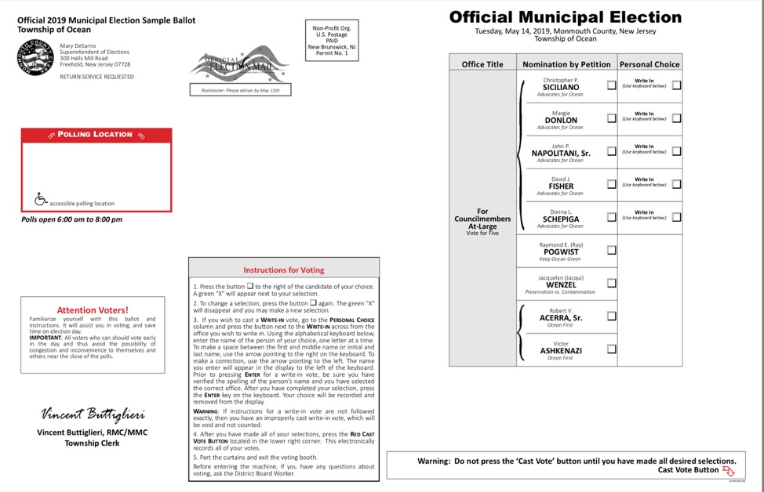
Sample Ballot
What
Where
How
Polling books
Notes:
Assure the students that they don’t have to remember all this. The SAMPLE BALLOT that is mailed to them one week before the election will have the WHAT, WHEN, WHERE listed for them.
The sample ballot is proof that you are registered.

Slide 69
If you were in charge of setting up voting
What would you worry about?
Need to know every voter is:
  Is eligible to vote
  Is who they say they are
  Gets just one vote
  Can vote in secret
  Has their vote counted - accurately
Notes:
Animated slide. Each click reveals another requirement of the voting system
We’ve covered the big picture of voting. Now let’s talk about what it’s actually like to go to the polls and cast your vote.”
Ask if anyone has gone to the polls with a parent—if anyone has been inside a voting booth. If yes, give them a chance to describe the experience.
Engage students in a discussion of what a voting system—to be fair and accurate— has to be able to do. “If you were in charge of setting up voting, what would you worry about?”
Reveal the ANSWERS : The voting system has to have a way to GUARANTEE that every voter:
1. Is eligible to vote
2. Is who they say they are
3. Gets just one vote
4. Can vote in secret
5. Has their vote counted—accurately
.

Slide 70
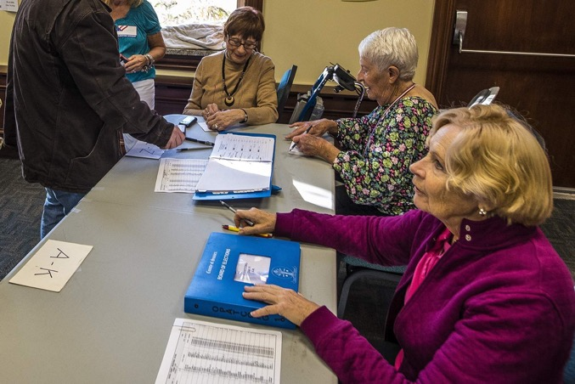
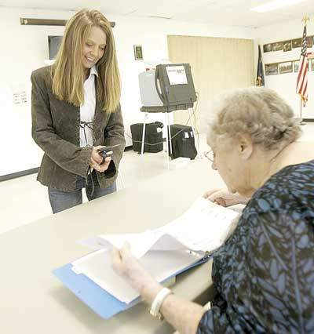
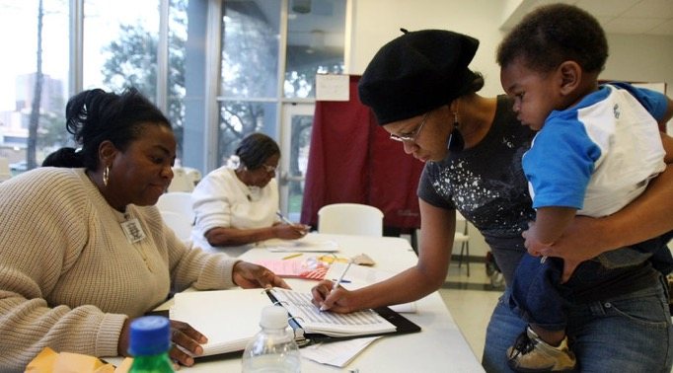
Eligibility
ID validation
Just one vote
How they handle
Polling books
Signatures
Polling books
Notes:
Eligibility: Do you meet the requirments?
When you arrive at the polls, you will see tables set up with big books, called POLL BOOKS, on them. Election poll workers will be sitting at the tables. The tables may be labeled by voting district—the number of your voting district will be on your SAMPLE BALLOT
“The POLL BOOKS list all the registered voters in a particular voting district. It is how the workers know you are eligible to vote. If you believe that you are registered, but your name is not in the book, ask for a PROVISIONAL BALLOT. The provisional ballot allows you to vote on paper on a special form that will be sealed and taken to the county for verification of your eligibility.
ID validation: Are you who you say you are?
The poll worker will ask you to sign your name in the Poll Book and will compare your signature to the one in the book. This step confirms you are who you say you are.”
New Jersey does not require voters to show identification at the polls—unless when you registered you did not give either a driver’s license number or the last four digits of your Social Security number. In this case, you’ll be asked to show identification at the polls
One vote: Have you already voted?
The poll book will show whether you have appeared at the polls to vote already in this election. And it will show if you applied for a vote-by-mail ballot.
You will sign a numbered ticket that you will take to the voting booth. The poll worker at the voting booth keeps the tickets The tickets allow the workers to confirm that the number of ballots cast equals the number of eligible voters who came through the process.”

Slide 71
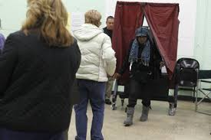
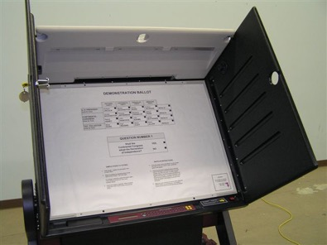
Privacy
How they handle
Curtains or shields
Notes:
Privacy: Was your vote a secret ballot?
The voting booths in New Jersey have a curtain that you pull closed when you enter. Some instead have shields on the sides.
The panel in the voting booth lists all the candidates and any public questions. You press a button next the candidates name to make your choice.
“YOU HAVE NOT VOTED UNTIL YOU PRESS THE GREEN BUTTON ON THE BOTTOM RIGHT OF THE PANEL! Until you press this button, you can change your choices. Once you press the button, your vote is cast and the choices on the panel are cleared off. The next person coming into the voting booth will not see how you voted.”
Your ballot cannot be traced back to you.

Slide 72


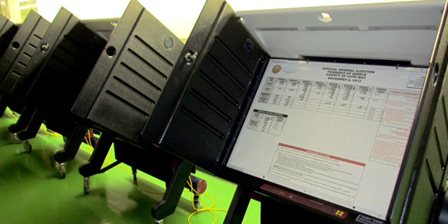
Security
How they handle
No voting machine conductivity
Notes:
Security: Was your vote counted--accurately?
New Jersey machines are electronic and they do not create a paper trail. That means there is no physical back-up that documents the ballot you cast when you push the green button in the voting booth, so there is no way to prove that a voting machine has been hacked.
New Jersey voting machines are not connected to the internet. If someone wanted to tamper with or hack the votes in an election, they would have to tamper with each individual voting machine.“
Assure the students that they don’t have to remember all this. What you’ve just walked through gives students a sense of what it will be like to go to the polls to vote. On Election Day, poll workers will help guide them through the process. AND THEY CAN MAKE VOTING A TEAM SPORT—GO TO THE POLLS WITH FRIENDS.

Slide 73
Notes:
[The League will work with the school to arrange voter registration drives separate from the Fighting for the Vote session. Assume that registering students is not part of this lesson.]
“We’ve gone through the Fight for the Vote, we’ve looked at the challenge of voter turnout, and we’ve walked through what it’s like to vote in person.”
Introduce the Voting Reminder number.
Hand out Voting Reminder/VOTE411 cards and explain:
Those who will be at least 18 by the General Election and who are or who intend to register can text the word VOTE to 732-927-1331. The nonpartisan League of Women Voters will text a reminder to vote on or close to Election Day. Assure them the information will be used FOR NO OTHER PURPOSE. If time permits, give students a chance to text their contact information in the room.

Slide 74
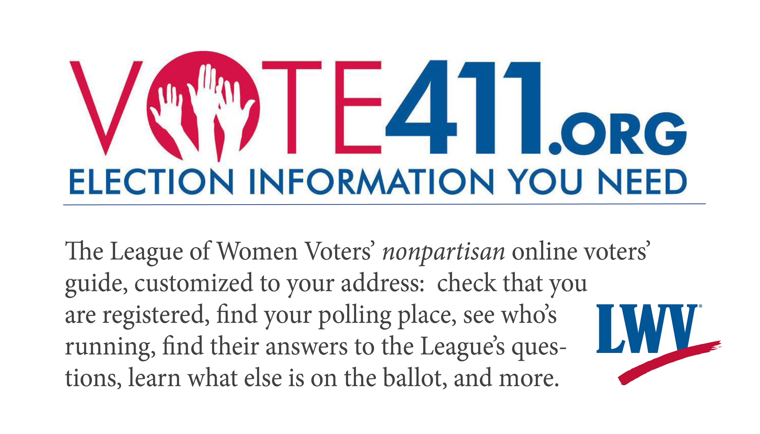
Notes:
“Point out that VOTE411 (on the other side of the card) has voter information tailored to you. You enter your address and see what will be on your ballot, where to go to vote, polling hours, and more. It also has a hotline to call if you have any trouble voting.”
Have voter registration forms available to pass out to anyone who needs them for themselves, friends, or family members
Have vote-by-mail applications available and ask if anyone would like one. Explain that if they will be away at school or in the military for the November election, they can fill out an application to receive a vote-by-mail ballot.

Slide 75

Notes:
Thank students for participating. Express your optimism for the future, if they choose the vote.

