Slide 1
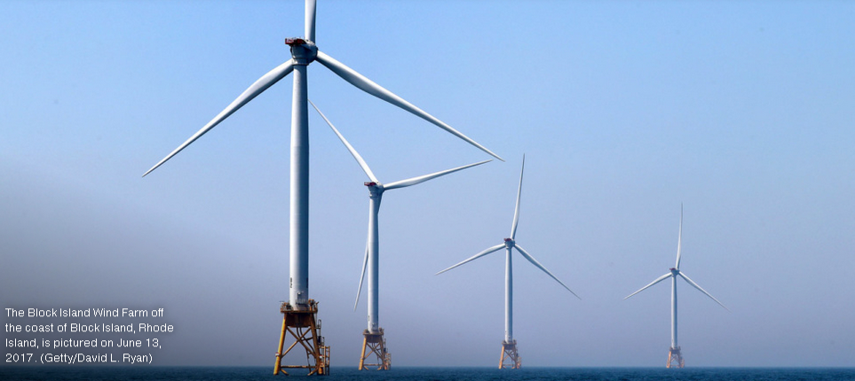
Environmental Assessment of NJ Offshore Wind;
An Overview
Photo Credit: Brian Skerry
Michael Gravitz, Director of Policy & Legislation
Marine Conservation Institute

Slide 2
Overview of Presentation
Introductions – Michael Gravitz & Marine Conservation Institute
Key questions to ask?
Evidence based answers from Europe versus
Speculation and maybe’s from U.S.
Impact Framework (construction vs. operation, drivers of impact, marine life impacted, human activities impacted)
Marine life impacts: the European experience mostly
Marine mammals
Fish (bottom and pelagic)
Sharks & rays (elasmobranchs)
Sea turtles
Invertebrates and benthos
Birds & bats
Fishermen (commercial & recreational)
Impact (Cost) of doing nothing on climate and oceans
Summary judgement

Slide 3
Ocean conservation; Why care about healthy oceans?
Oceans are a planetary Life Support system…”No blue, No green; No ocean, No life” – Dr. Sylvia Earle
70% of planet’s surface (60% high seas and 40% EEZ’s)
Contain over 90% of Earth’s living space for living things
Over 150,000 species identified; but that is estimated to be only 10% of total marine biodiversity
Ocean is warming, acidifying, becoming more polluted with plastics, nutrients, and chemical pollutants – many long-lived
Vital for food, transportation, recreation, and spiritual enjoyment

Slide 4
Ocean Conservation = Planetary life support
Services that oceans provide are a planetary life support system:
Moderate and control climate
Produce one-half of oxygen we breathe
Soak up 90% of the excess heat generated
Store 25% - 35% of the CO2 we emit
Primary source of protein for one billion people
Healthy ocean coastlines (mangroves, marshes, reefs) protect from storms, floods, sea level rise

Slide 5
Key questions to consider
What are the sources of offshore wind impact on marine life and humans?
Noise
Sediment
Structures below (support towers) and above water (blades)
Electromagnetic
Increased boat traffic
Navigation
Potential area closures
Visual/aesthetic
Others
Construction (one-time) vs. operation impacts (chronic)
3. What are impacts on ocean and marine life if we do nothing to increase renewables, especially offshore wind energy
4. How to balance impacts of doing and not doing offshore wind

Slide 6
Where does the impact information come from? European experience with wind farms
As of 2020, Europe had approximately 5,400 turbines offshore. See https://windeurope.org/intelligence-platform/product/offshore-wind-in-europe-key-trends-and-statistics-2020/
12 countries
Generating capacity of over 25 gigawatts. A gigawatt is enough to power about 750,000 homes.
In 2020, Europe invested $32 billion in new offshore wind assets and almost 2 gigawatts of new capacity came online

Slide 7
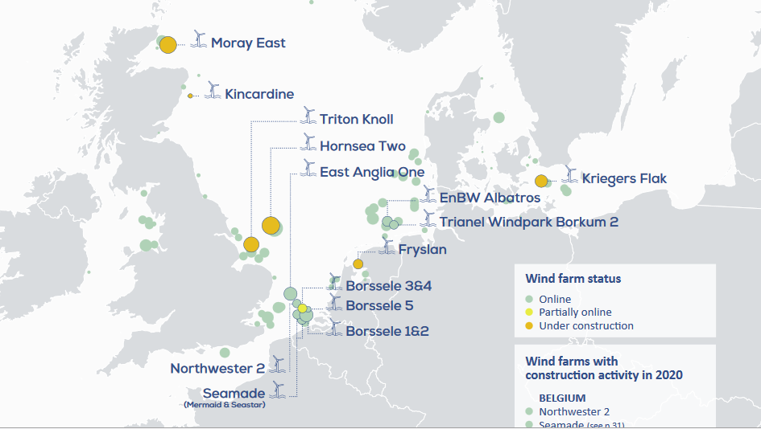
European windfarm locations: North Atlantic, North Sea, Baltic (different than mid Atlantic)

Slide 8
Sources: mostly European studies
Baily, H. et al. (2014) Assessing environmental impacts of offshore wind farms: lessons learned and recommendations for the future. Aquatic Biosystems
Center for American Progress (2022) The road to 30 gigawatts: Key actions to scale an offshore wind industry in the United States.
Degraer, S. et al editors (2019) Environmental impacts of offshore wind farms in the Belgian part of the North Sea; Marking a decade of monitoring, research and innovation. Royal Belgian Institute of Natural Sciences, OD Natural Environment, Marine Ecology and Management
Discovery of Sound in the Sea sponsored by University of Rhode Island Graduate School of Oceanography (www. dosits.org) Wind Turbine. At https://dosits.org/animals/effects-of-sound/anthropogenic-sources/wind-turbine/
Hutchinson, Z. et al. (2020) Anthropogenic electromagnetic fields (EMF) influence the behavior of bottom dwelling species. Nature Scientific Reports
North Carolina Seagrant. (2021) Do offshore wind farms [Block Island] affect recreational fishing? At https://ncseagrant.ncsu.edu/hooklinescience/2021/09/20/do-offshore-wind-farms-affect-recreational-fishing/ Based on
Symthe, T. et al (2021) Optimistic with reservations: The impacts of the United States’ first offshore wind farm on the recreational fishing experience. Marine Policy
Susan Phillips (2021). Jersey shore’s fishing industry wonders: Can it can co-exist with industrial-sized wind farms? NPR 9/24/21
https://stateimpact.npr.org/pennsylvania/2021/09/24/jersey-shores-fishing-industry-wonders-can-it-coexist-with-industrial-sized-wind-farms/
Stenburg, C. et al. (2015) Long-term effects of an offshore wind farm in the North Sea on fish communities. Marine Ecology Progress Series. May
Van Hoey, G. et al (2021) Overview of the effects of offshore wind farms on fisheries and aquaculture. Publications office of the European Union.

Slide 9
Driver of Impact: Noise
Three phases:
pre-construction -seismic testing (one time)
construction - pile driving for towers (one time but over years) and vessel traffic
operations produce vibrations (chronic) and much less vessel traffic
Construction noise – very loud 150-200 dB impacts fish, marine mammals, turtles. Physiological damage and behavioral changes. Mobile species often flee.
One study showed increased stranding of harbor porpoises
whales observed to avoid construction area
Some fish move away
Mitigation: bubble curtains, seasonal construction to avoid migrations/aggregations, phased construction, aerial surveillance for marine mammals.
Operation noise – much less than construction and low frequency. “It is unlikely that the operational turbine sounds reach levels sufficient to cause temporary or permanent threshold shifts at any distance from turbines”. –Discovery of Sound at Sea

Slide 10
Driver: Structures below water
Collisions with marine mammals, sea turtles, fish
Pretty rare or nonexistent. Most navigate with sight, sound, or other
Changes to benthic habitats
Disturbed areas at base of towers and slower current around the towers
Stenberg (2015) found at Horns Reef Rev 1 that overall fish abundance was same after 7 years comparing pre and post construction. Fish species diversity increased near turbines due to Reef Effect with rocky habitat.
No impact on abundance or species that prefer sandy habitat between turbines.
Fish abundance outside windfarm declined during the period, so windfarm may have served as a refuge.
In Belgian windfarms (Degrear ed. 2019) benthic communities stabilized after 10 years on the foundations and towers but different than natural hard bottom
Changes to pelagic (water column) habitats
More structure usually means more ecosystem complexity and food, potentially different predator-prey relationships, etc.
Positives: reef effect from towers and foundations, refuge effect if closed to fishing

Slide 11
Driver: Structures above water
Potential collisions with boats, fishing boats, marine mammals, birds, etc.
Bird or bat avoidance, attraction, or collisions with towers and blades
Belgian studies (Dragaer ed. 2019) shows avoidance of gannets, guillemots and razerbills but attraction for gulls & cormorants, comparing pre and post construction.
No conclusion about long term impacts of displacement on fitness, reproduction or population size.
No data on death or damage from collisions.
Impact potential is site specific, species specific and seasonal
Avoidance of towers can effect migratory pathways and foraging areas. Avoidance and displacement can cause changes in energetic requirements, fecundity and populations.

Slide 12
Driver: Additional boat traffic
Large increase in boat traffic during construction phase; much smaller increase in operation phase.
Boat traffic produces marine noise, some pollution from exhaust and anti-fouling paints.
Judgement: temporary, not long term impact

Slide 13
Driver: Electromagnetic fields (EMF) mostly on the bottom
Many taxa of marine animals have electro and/or magnetic senses; there are several known sensory systems.
Used by marine life for: navigation, migration, detecting prey and predators, communicating, and reproduction depending on species.
Wind farms and underwater electric cables produce weak EMF but so do bridges, existing electric and communication cables, and ships.
Studies (Hutchison 2020) on skates and lobster do show changes in behavior (exploratory and foraging) in presence of EMF mimicking underwater cables.
No conclusion on impact positive or negative or significance in situ.

Slide 14
Driver: Fisheries off NJ
Why fisheries? Because they have large impact on NJ ocean and local economy.
Belgian experience (Degreaer 2019): fishermen adapted to exclusion areas, some bottom fish like plaice (flounder like) showed increased landings and CPUE. Block Island experience reported good by recreational fishermen.
Scallops, clams, summer flounder, scup, are all bottom dwellers or just below the surface and harvested with bottom trawls or hydrologic dredges for clams
Impacts include benthic damage, sediment plumes, and noise though most bottom is sandy or muddy so recovers.
Impact magnitude: at least 20,000 acres swept or dredged per year
Approx. 35,000,000 lbs of scallops and clams per year / 2,000 lbs per acre =
17,500 acres swept plus summer flounder and scup trawling)
Approx. 66% of value of NJ landings in 2020 (total $185 million) were invertebrates like scallops and clams all harvested with dredges or bottom dragging trawls.
Source of data: https://www.fisheries.noaa.gov/national/sustainable-fisheries/commercial-fisheries-landings
Some evidence that bottom trawling and sediment plumes release significant C02 into the atmosphere; not good for global warming. Sala et al 2021, Atwood et al

Slide 15
Net Net: The earth is burning up; we must do something even if there are small/unknown environmental impacts from offshore wind
30 years of European experience shows impacts are marginal and manageable.
BUT we know well what the impact of global warming is on oceans, marine life, sea level rise, humans, fisheries, hurricanes, etc. We have a good idea of impacts if we don’t reach net zero by 2050 or before. To do that we must be 100% renewable electricity well before that.
Would you stop a windfarm project that replaced fossil fuel electricity (48% of NJ electricity) and C02 emissions with renewables because of a small impact?
Do we have a choice, realistically, to find 7.5 gigawatts of renewables some other way for NJ? Enough for 5.6 million households (3.6 million in NJ)

Slide 16
Marine Conservation Institute
Contact:
Michael Gravitz, Director of Policy Michael.Gravitz@marine-conservation.org
See:
www.marine-conservation.org
https://marine-conservation.org/scientific-support/
www.mpatlas.org
www.blueparks.org

