Slide 1


Student Advocate Toolkit
In the time of COVID-19
How to Help Others Register and Vote from Home
1

Slide 2






Where are the decisions on these issues made?
Washington (Federal)? Trenton (State)? Freehold (County)? Our town/city (Local)?
The Environment
It’s important to vote in every election: National, State, County, and Local
2
2

Slide 3

What happens when you don’t vote ?
People in power listen to those who put them there
(the groups who vote).
The higher the voter turnout, the stronger a group’s voice.
    No vote, no voice.
3

Slide 4

Who is being heard ?
How loud is YOUR voice? How can you make it louder?
4
Notes:
.

Slide 5

Why is this so important now?
Voters pick the party candidates:
PRIMARY
July 7, 2020
Voters decide:
President and Vice President
Congress—Senate and House
Freeholder
County Clerk and other county officials
Local town/city officials
GENERAL ELECTION November 3, 2020
+
Local School Board
NJ Constitutional Amendments
Property Tax Deduction and Exemption for Peacetime Veterans
Legalize Marijuana
5

Slide 6
Three steps for voting
Commit
Vote
Register
1
2
3
6

Slide 7


Are you eligible to register?
Yes! If you are . . .
A U.S. citizen
At least 17 years old
(But you can not vote until you turn 18)
A resident of the county for 30 days before the election
Not serving a prison sentence for a felony
NEW ! You can vote if you are on parole or probation but you need to register—even if you were registered before.
7

Slide 8

Are you already registered?
If you got your NJ driver’s license since 2018, you were registered to vote—unless you chose to OPT OUT
If you registered recently, you received a voter acknowledgment card in the mail. If you registered in the past, you may have received a voter id card. (Neither of these cards is required to actually vote.)
If you are 18 years old or older, you can check at vote411.org.
If in doubt, REGISTER
8

Slide 9
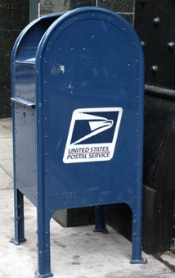
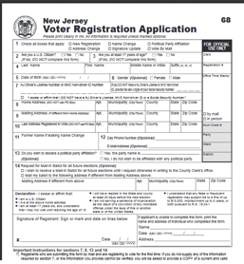
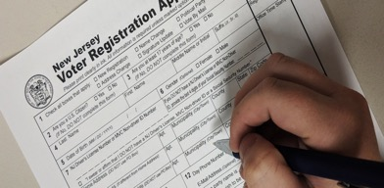
How do you register to vote?
Online registration will be available in NJ by July 2020
Get a registration form
Fill it out
Mail it in
For now
9

Slide 10
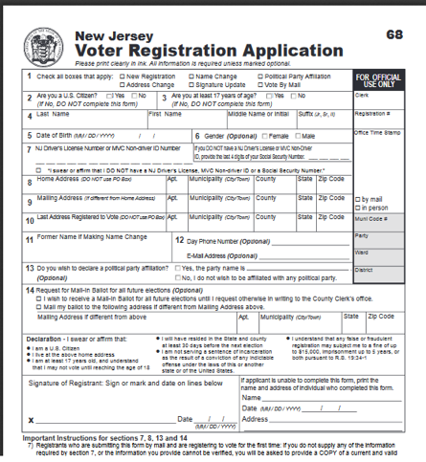
Get the Voter Registration Application From Home
Print from this website:
    https://www.state.nj.us/state/elections/voter-registration.shtml
  For English or Spanish: Select “Monmouth County” (or your county)
  For other languages:
  Scroll to the bottom of the County List and
  click on “Statewide Voter Registration Forms”
      - OR -
Text “REGISTRATION FORM” to the League of Women Voters
(732-927-1131) and they’ll be in touch and mail one to you
10

Slide 11

Use pen, not pencil!
How to fill out the Voter Registration form
Online form
VIDEO

Slide 12
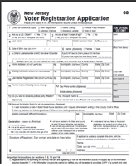



Mail it!
Fold and tape your form and
drop it in a mailbox.
Your form is already addressed and stamped.
Once registered, you stay registered and do
not need to submit another form unless you change your address, name, signature, or party affiliation.
DEADLINE: 21 days before Election Day
June 16, 2020 for the July 7 NJ Primary Election
October 13, 2020 for the General Election
12

Slide 13
Next . . .
Commit
Vote
Register
2
1
3
13

Slide 14


No Excuses!
No Excuses !!
Are you thinking…?
Voting by mail is hard.
It doesn’t matter who is elected. They all act the same once they are in office.
This is such a crazy time. I’m too preoccupied to vote.
My faith in the system and fairness in voting is utterly crushed.
My mail-in ballot won’t be counted.
My vote is largely symbolic because of the Electoral College. I live in a ”blue” state.
HINT: Responses are in the Toolkit Guide
14

Slide 15


Make a plan
Ask yourself:
When is the election?
July 7, 2020 Primary
November 3, 2020 General
How will I vote?
By mail? In person?
If by mail, how do I get a mail-in ballot?
How will I know who and what to vote for?
15

Slide 16


July 7, 2020 PRIMARY
Can you vote?
For the 2020 Primary ONLY, unaffiliated voters will automatically receive an application for a mail-in ballot. It will have a place to declare your party if you choose to vote in the Primary.
You must declare as either a Democrat or Republican
You stay affiliated with that party until you submit paperwork to change to “unaffiliated” or to a different party
(due at least 55 days before the Primary)
Unaffiliated is not the same as Independent!
16

Slide 17
July 7, 2020 PRIMARY
In person or by mail?
RECOMMENDED
In Person
By Mail
Special process for this Primary
Special process for this Primary
Ballots mailed automatically to registered Dem and Reps
Special vote-by-mail applications mailed automatically to unaffiliated registered voters
Fewer polling places
A least one in each town
Paper (provisional) ballots
Machine for voters with special needs
All standard Covid-19 precautions
17

Slide 18
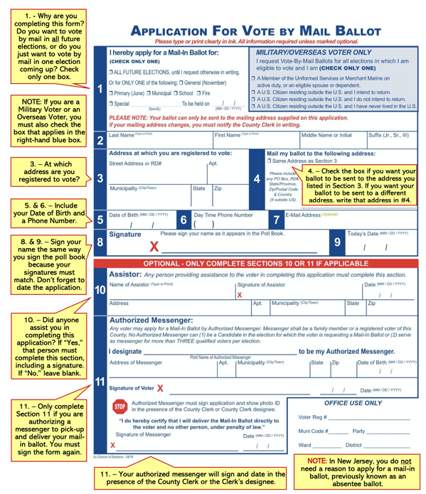
How do you fill out the Vote-by-Mail application?
There will be a customized application for Vote-by-Mail Ballot for the July 2020 Primary ONLY. It will have a place to declare your party, if you want to vote in the Primary.

Slide 19
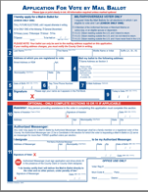


Mail the application for a vote-by-mail ballot
Fold and tape your form and drop it in a mailbox
Your form is already addressed and stamped
You will receive your mail-in ballot by mail in time to cast your ballot in the election
DEADLINE: The County election office must receive your application in the mail at least 7 days before the election.
(IN NORMAL TIMES, a voter can apply in person to the County Clerk in Freehold up to 3 p.m. the day before the election.)
19

Slide 20
Who should you vote for?
Find candidates who share your values and priorities.
VOTE411.com can help
Detailed candidate information at all levels
Information about ballot questions
COVID-19 related changes to election dates and processes
On VOTE411 you can also:
Check registration status
Get a mail-in ballot application
Find a first-time voter checklist
20

Slide 21
Next . . .
3
VOTE
2
1
Register
COMMIT
21

Slide 22

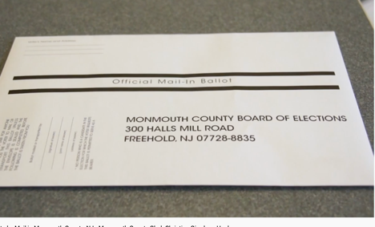
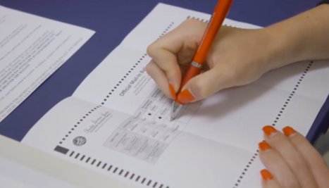
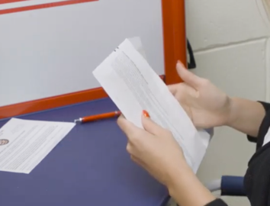
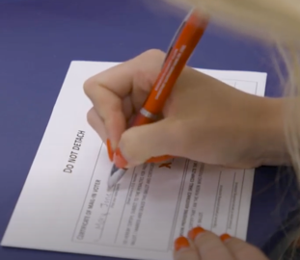
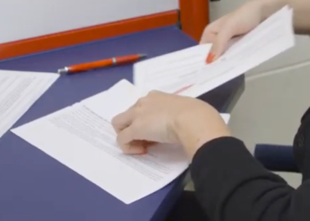
How do you fill out the
Vote-by-Mail ballot?
1
2
VIDEO
How to vote by mail
You’ll receive a package in the mail.
It contains your ballot and two envelopes.
Fill in the circles on the ballot to mark your choices. Use a blue or black pen—not pencil or marker. The ballots are scanned by machine.
3
4
5
Put the ballot in the smaller envelope. Do not detach or damage the flap!
Complete the information on the outside of the smaller envelope and sign.
Place the smaller envelope in the larger envelope and seal.
It is self-addressed and stamped.
22

Slide 23

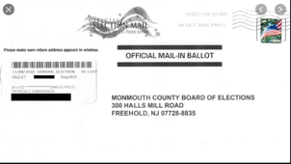

Mail it!
For the July 2020 Primary the County will also set up secure DROP-OFF SITES where you can deliver your ballot.
Drop your ballot in a mailbox or drop-off site
Congratulations, you’ve cast your VOTE!
DEADLINE: Postmarked by Election Day.
For 2020 Primary, deadline for receipt by
County is 7 days after polls close.
MAIL EARLY TO AVOID ANY PROBLEMS !!!!!!
Changed from 2 days just for the 2020 Primary
23

Slide 24
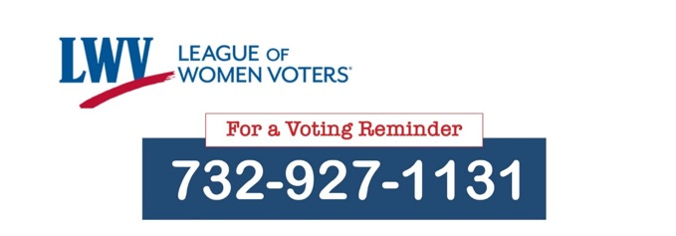
THE BIG IDEAS
1
2
3
Register
Commit
Vote
At least 17 and a citizen
Forms available online and from LWV
DEADLINE: 21 days before election
Apply for a vote-by-mail ballot (online and from LWV)
DEADLINE: 7 days before Election
Complete your mail-in ballot
Mail your ballot
DEADLINE: Postmarked no later than Election Day
Text for help
24

Slide 25

Need more information
  League of Women Voters materials
        lwvsmc.org/covid.php
      Vote411
      text questions to 732-927-1131
NJ Division of Elections
Monmouth County Votes
25

