Slide 1
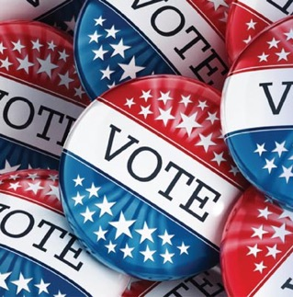

Voting Advocate Toolkit
In the time of COVID-19
Voting in the
2020 NJ Primary
A NON-PARTISAN GUIDE
Resources
Notes:
What can you do as a Voting Advocate
Covid-19 may mean that most or all of us will need to cast our votes using vote-by-mail. Many people have never done so before, and they may need assistance and encouragement to do so. The people you talk to may not be registered and may also need assistance with voting by mail. We hope you can be the person who will help them overcome barriers to voting.
This toolkit includes a ‘how-to’ presentation that equips you to help others vote in the upcoming elections safely by using the vote-by-mail process. It includes two short videos, and will help you talk with others about:
How to check to see if they are already registered to vote, and, if not, how to register.
Why we may need to use mail-in voting this year for health and safety reasons.
How to request and then cast a mail-in ballot.
Offering your help and encouragement.

Slide 2

The Covid-19 crisis
threatens our 2020 elections
PRIMARY
July 7, 2020
GENERAL ELECTION November 3, 2020
Voters pick the party candidates:
Voters decide:
President and Vice President
Congress—Senate and House
Freeholder
County Clerk and other county officials
Local town/city officials
+
NJ Constitutional Amendments
Property Tax Deduction and Exemption for Peacetime Veterans
Legalize Marijuana
2
Notes:
(THIS SLIDE IS ANIMATED)
The situation is urgent! The shutdown and dangers imposed by Covid-19 pose a threat to our elections in a critical election year. States—including New Jersey-- are having to redesign the voting process to allow people to vote by mail and to provide safe polling places. The changes are leaving voters uncertain about how things will work—and can lower voter turnout. Two important elections are affected. One is just around the corner.
Primary election:
The Primary is an election run by the major parties—the Democrats and the Republicans—to choose their candidates to run in the General Election in November. You must be affiliated with a Party to vote in its election. Because of the coronavirus crisis, the Governor of New Jersey moved the Primary from June 2 to July 7.
General election: Individuals vote their choice for President, Senator and Congressperson, and offices at the state, county, and local levels. In the general election, you do not have to declare a party. You can vote for a candidate from any party. The General Election is set by law as the first Tuesday after the first Monday in November. Some or all of the new procedures installed for the Primary may still be in effect for the 2020 General Election.
Public questions: In the general election this year, you will also be voting on two state-wide public questions: whether or not to give a property tax deduction and exemption for veterans who served during peacetime rather than only wartime, and whether or not to legalize marijuana.

Slide 3
We need to protect voters, poll workers, and the election itself
Here’s how . . .
Commit
Vote
Register
1
2
3
FROM HOME!
3
Notes:
Using this toolkit to keep voters and poll workers safe—and encourage voter turnout.
This toolkit teaches how to Register, Commit to voting, and then Vote—safely, from home.
WHEN YOU ARE IN THE PRESENTATION MODE, clicking on the blue links in the presentation will take you directly to the indicated webpage. You exit the Slideshow mode by pressing ESC.
We are also promoting the use of www.VOTE411.org, the League of Women Voters website with complete voting information.
If you have any questions, email us at lwvsmcnj@gmail.com or text us at 732-927-1131.

Slide 4

No Excuses!
No Excuses !!
What some non-voters say . . .
Voting by mail is hard.
It doesn’t matter who is elected. They all act the same once they are in office.
This is such a crazy time. I’m too preoccupied to vote.
My faith in the system and fairness in voting is utterly crushed.
My mail-in ballot won’t be counted.
Politicians don’t care about us. They only come around when they want our vote.
Notes:
Here are possible responses to the pushback you may hear:
Voting by mail is hard – “I can walk you through all the steps to register, get a mail-in ballot application, and fill in the mail-in ballot. I’m here to help!”
My mail-in ballot won’t be counted – “As long as it is received by the deadline, it will be counted. This won’t even be an issue if the Governor says that this year the entire election will be done via mail-in ballot.”
This is such a crazy time. I’m too preoccupied to vote – “We are all nervous about the Covid-19 virus and the effect it has on every aspect of our lives. That is why it is important to vote for the candidates who you think will be able to handle the crisis and its aftermath in the best way.”
It doesn’t matter who is elected. They all act the same once they are in office – “There are real differences between candidates. You can look them up on vote411.org to see where they stand on various issues. And you can ‘attend’ the virtual candidate forums sponsored by the League of Women Voters.”
Politicians don’t care about us. They only come around when they want our vote.
Politicians pay attention to groups of voters. Your vote is stronger when enhanced by others in your age group, racial or ethnic group, and neighborhood."
Slide 9 - Add "tape (not staple)..."
My faith in the system and fairness in voting is utterly crushed – “Faith in the system and fairness in voting are important in a democracy. Not voting, however, allows someone else to make all the decisions that will affect your future. In a democracy, voting gives you the best shot at making democratic elections work. Giving up that right means democracy dies.”

Slide 5

Can I vote in the Primary?
For the 2020 Primary ONLY, unaffiliated voters will automatically receive an application for a mail-in ballot with e a place to declare your party if choose to vote in the Primary.
PRIMARY
July 7, 2020
You must be registered
You must declare as either a Democrat or Republican
You stay affiliated with that party until you submit paperwork to change to “unaffiliated” or to a different party
(due at least 55 days before the Primary)
Unaffiliated is not the same as Independent!
Notes:
If a person has registered and will be at least 18 by July 7, they are eligible to vote in the New Jersey Primary. Because of the COVID crisis, the Governor moved the date of the Primary from June to July 7. This is good news for anyone who will turn 18 between June 2 and July 7!
The Primary is an election run by the major parties—the Democrats and the Republicans—to choose their candidates to run in the General Election in November.
In New Jersey, you can’t vote in the Primary unless you DECLARE your PARTY AFFILILATION. That means, you have to officially say whether you are a Democrat or Republican For the 2020 Primary, all registered, unaffiliated voters will automatically receive an application to vote-by-mail that includes a place to declare your party affiliation IF YOU CHOOSE TO VOTE IN THE PRIMARY.
IF YOU DON’T CHOOSE TO VOTE IN THE PRIMARY, you don’t have to say whether you are a Democrat, Republican, or some other party. You can be UNAFFILIATED. (UNAFFILIATED means you are not identifying with any party. It is not the same as INDEPENDENT! Independent can be the name of a party.)
Once you officially declare your party, you stay registered as a member of that party until you submit a change. This must be done on paper. It can’t be done at the polls. And your paper request must be received 55 days before the Primary.

Slide 6
July 7, 2020 PRIMARY
In person or by mail?
RECOMMENDED
In Person
By Mail
Special process for this Primary
Special process for this Primary
Ballots mailed automatically to registered Dem and Reps
Special vote-by-mail applications mailed automatically to unaffiliated and inactive* registered voters
Fewer polling places
A least one in each town
Paper (provisional) ballots
Machine for voters with special needs
All standard Covid-19 precautions
* Inactive voters are those who have not voted in the last two federal elections.
Notes:
For the upcoming July 7 Primary, the rules for both In-Person and By-Mail voting are changed to keep voters and poll workers safe.
It will still be possible to vote in person, but there will be fewer polling places (Where you go to vote). Everyone will vote on a paper ballot—called a provisional ballot. Only people with special needs, for whom voting on a paper ballot is a hardship—like the blind, will vote by machine at the polls. All the Covid-19 rules—like 6-ft. social distancing, wearing masks, sanitizing the polling place, etc.—will be in force.
The League of Women Voters and the election officials STRONGLY RECOMMEND voting by mail in the July Primary. To make that recommendation work, the process has been modified, and we’ll go into those changes in more detail in a few minutes. For now, to summarize (remembering that only voters who have declared as a Democrat or Republican can vote in the Primary);
Democrats will automatically receive a vote-by-mail Democratic ballot
Republicans will automatically receive a vote-by-mail Republican ballot
Unaffiliated voters (those who have not declared for any party) will automatically receive a postage-paid, self-addressed application for a vote-by-mail ballot to fill out and mail.
IF YOU VOTE BY MAIL, DO NOT GO TO THE POLLS TO VOTE IN PERSON. IF YOU RECEIVE A MAIL-IN BALLOT AND CHOOSE INSTEAD TO VOTE IN PERSON, YOU CAN CAST A PROVISIONAL BALLOT. ONCE OFFICIALS CONFIRM YOU HAVENT VOTED BY MAIL, YOUR VOTE WILL BE COUNTED.
Note (if asked)

Slide 7
July 7, 2020 PRIMARY
Neptune Polling Places
Registered voters will receive a postcard identifying their polling place.
In Person
Special process for this Primary
Washington Fire House
Olin and Central in Ocean Grove
1, 2, & 3
Neptune Senior Center
1607 Corlies Ave.
7, 8, 9, 11 & 12
Shark River Hills Fire House
200 Brighton Ave
4, 5, 13 & 16
Summerfield School
1 Summerfield Ln. (on Green Grove Rd.)
6, 10, 14, 15, 17, 18, 19 & 20
Fewer polling places
A least one in each town
Paper (provisional) ballots
Machine for voters with special needs
All standard Covid-19 precautions
Notes:
For the upcoming July 7 Primary, the rules for both In-Person and By-Mail voting are changed to keep voters and poll workers safe.
It will still be possible to vote in person, but there will be fewer polling places (Where you go to vote). Everyone will vote on a paper ballot—called a provisional ballot. Only people with special needs, for whom voting on a paper ballot is a hardship—like the blind, will vote by machine at the polls. All the Covid-19 rules—like 6-ft. social distancing, wearing masks, sanitizing the polling place, etc.—will be in force.
The League of Women Voters and the election officials STRONGLY RECOMMEND voting by mail in the July Primary. To make that recommendation work, the process has been modified, and we’ll go into those changes in more detail in a few minutes. For now, to summarize (remembering that only voters who have declared as a Democrat or Republican can vote in the Primary);
Democrats will automatically receive a vote-by-mail Democratic ballot
Republicans will automatically receive a vote-by-mail Republican ballot
Unaffiliated voters (those who have not declared for any party) will automatically receive a postage-paid, self-addressed application for a vote-by-mail ballot to fill out and mail.
IF YOU VOTE BY MAIL, DO NOT GO TO THE POLLS TO VOTE IN PERSON. IF YOU RECEIVE A MAIL-IN BALLOT AND CHOOSE INSTEAD TO VOTE IN PERSON, YOU CAN CAST A PROVISIONAL BALLOT. ONCE OFFICIALS CONFIRM YOU HAVENT VOTED BY MAIL, YOUR VOTE WILL BE COUNTED.
Note (if asked)

Slide 8
How do you fill out the Vote-by-Mail application?
The VBM application for the 2020 NJ Primary has been customized for this election.
Notes:
The basic purpose of the application is to give the County the address where you want your mail-in-ballot to go. Right now, it is probably your home address, but if you are going away to college next year, you would give them your college address for the November election.
The County will check that you are a registered voter and send you your mail-in ballot. “
Look through the fields on the form, using the information in the yellow bubbles on the slide.
ALL UNAFFILIATED REGISTERED VOTERS WILL BE MAILED APPLICATIONS FOR VOTE-BY-MAIL BALLOTS FOR THE 2020 PRIMARY. IT WILL INCLUDE A PLACE TO DECLARE PARTY AFFILIATION, IF THEY CHOOSE TO VOTE IN THE PRIMARY.

Slide 9
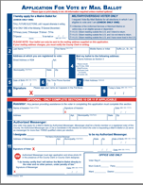


Mail the application for a vote-by-mail ballot
Fold and tape your form and drop it in a mailbox
Your form is already addressed and stamped
You will receive your mail-in ballot by mail in time to cast your ballot in the election
DEADLINE: The County election office must receive your application in the mail at least 7 days before the election.
(A voter can apply in person to the County Clerk in Freehold before 8 p.m. the day of the election.)
Notes:
Your Vote-By-Mail application is self addressed and for the 2020 Primary, it is also postage paid.
All you need to do is drop your application in the mail at least 7 days before the election. Because of the large volume of Vote-By-Mail applications expected for the Primary, mail your application as early as possible!

Slide 10
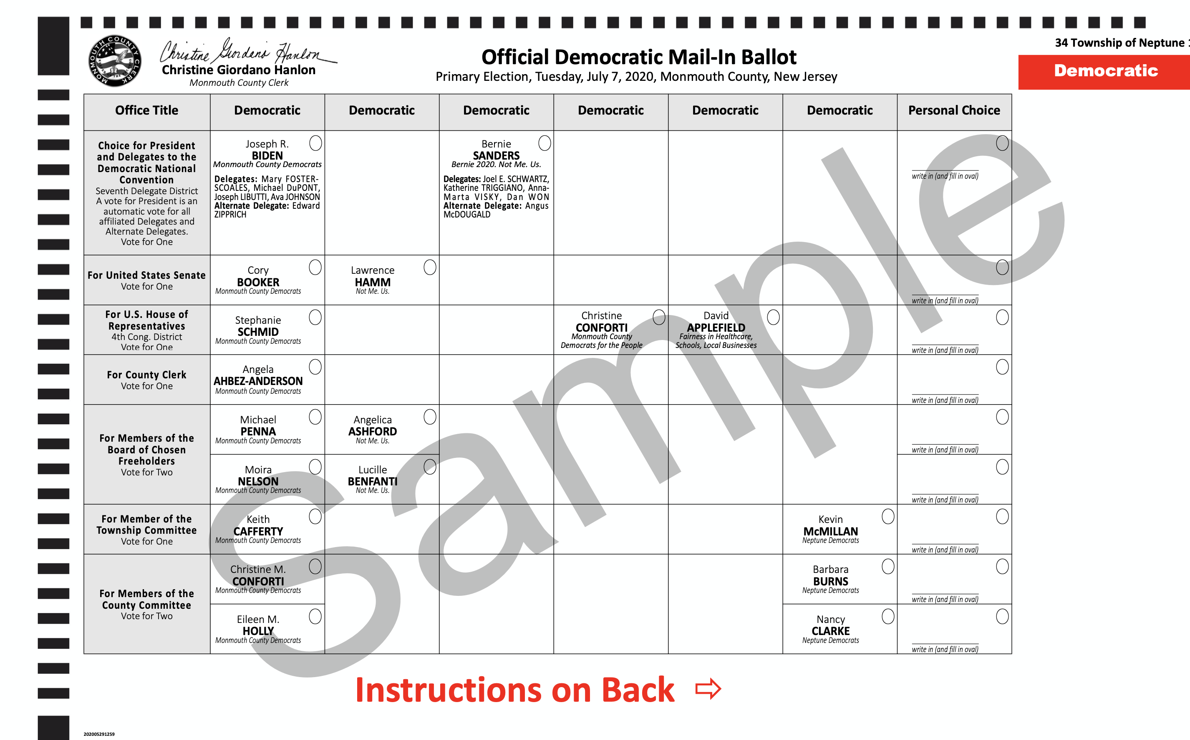
Neptune Democratic Ballot
Candidates for County Democratic Committee differ based on voting district
10
Notes:
How to read the Ballot
This is a sample of the ballot Democrats registered in Neptune will receive for the 2020 Primary
Each row shows the candidates for a given elected position (read a row)
Each column labeled “Democrat” holds candidates running under a particular group within the Democratic Party. The first column is the Party-endorsed candidates. Highlight the group label under the candidate name for a few other columns.
The final column is for write-in candidates

Slide 11
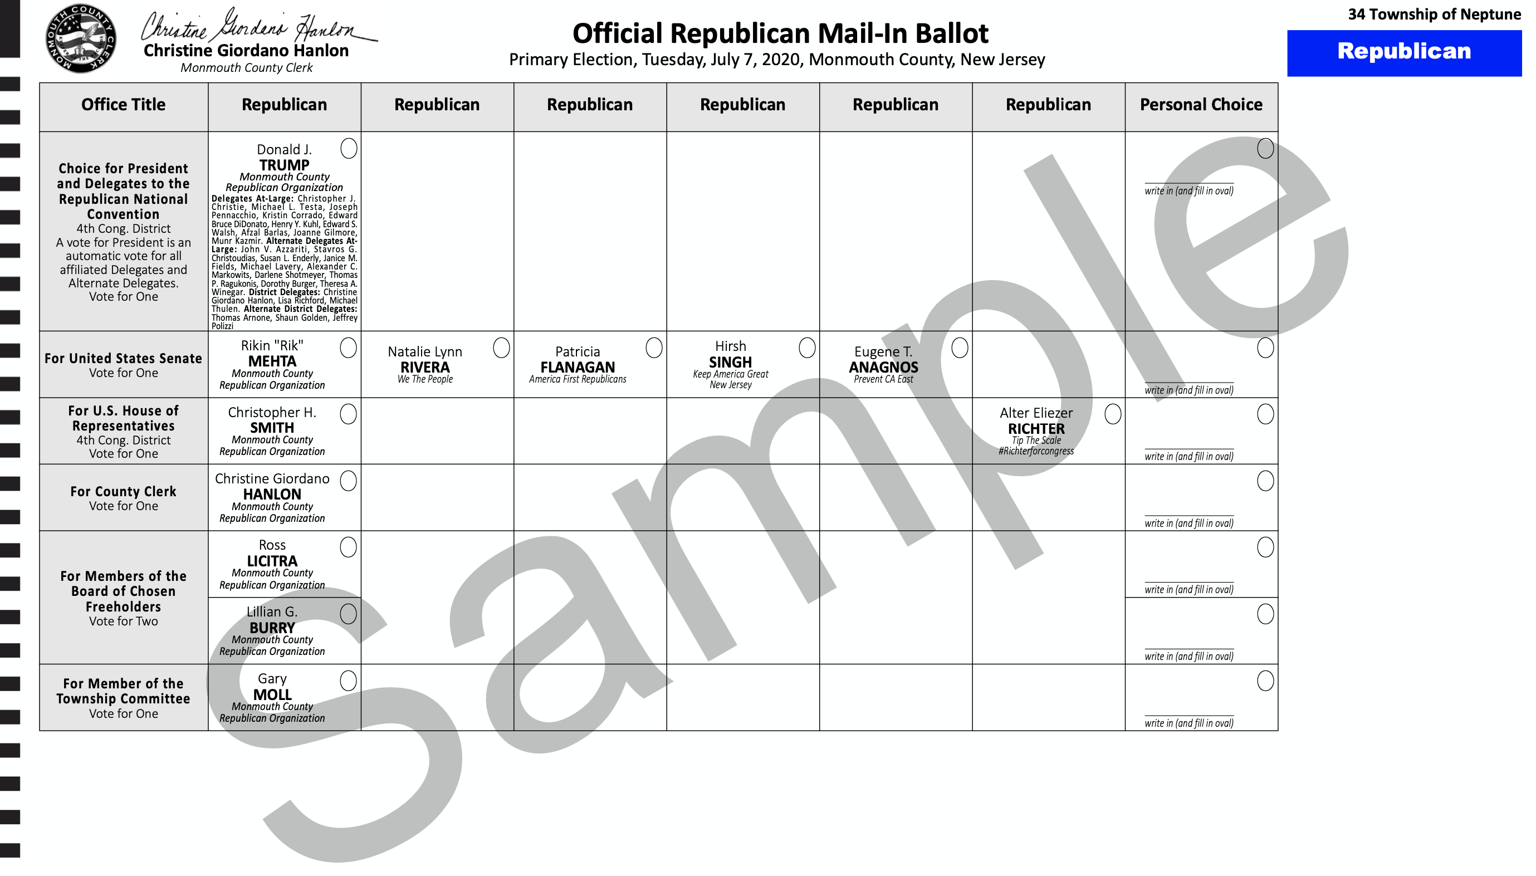
Neptune Republican Ballot
Candidates for County Republican Committee differ based on voting district
11
Notes:
This is a sample of the ballot a Republican registered in Neptune will receive for the 2020 Primary.
You read it in the same way.

Slide 12

Who should you vote for?
Find candidates who share your values and priorities.
Vote411.com can help
Detailed candidate information at all levels
Information about ballot questions
COVID-19 related changes to election dates and processes
On VOTE 411, you can also
Check registration status
Get a mail-in ballot application
Find a first-time voter checklist
12
Notes:
VOTE411.org is the League of Women Voters nonpartisan voters guide that provides customized information on voting. Users enter their address and can see what will be on the ballot when they vote. They can see biographical information and answers to League-posed questions from candidates who respond to the League’s invitation to participate.
VOTE411 provides candidate information down to the local level, information on ballot issues, updates on COVID-19-related changes to elections, and links that allow users to check their registration status and much more.

Slide 13
Next . . .
3
VOTE
2
1
Register
COMMIT
13
Notes:
The League of Women Voters is strongly encouraging those who can to vote by mail. (Each municipality will have at least one polling place where voters will cast paper ballot and those with special needs can vote by machine.)
The material that follows shows how to vote by mail

Slide 14

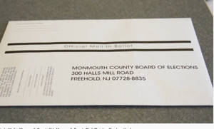
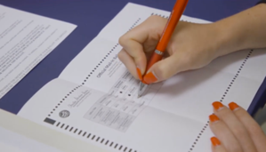
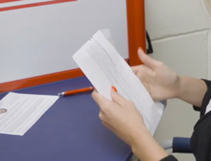
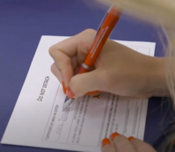
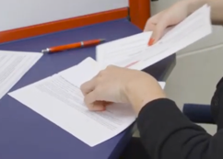
How do you fill out the
Vote-by-Mail ballot?
1
2
VIDEO
How to vote by mail
You’ll receive a package in the mail.
It contains your ballot and two envelopes.
Fill in the circles on the ballot to mark your choices. Use a blue or black pen—not pencil or marker. The ballots are scanned by machine.
3
4
5
Put the ballot in the smaller envelope. Do not detach or damage the flap!
Complete the information on the outside of the smaller envelope and sign.
Place the smaller envelope in the larger envelope and seal.
It is self-addressed and stamped.
Notes:
There are two options for how to learn how to fill out a mail-in ballot:
Read through the basic steps on this slide.
Click on the “VIDEO” hyperlink and play the Monmouth County Clerk video (~2 minutes) on Voting By Mail in Monmouth County. You must be in the “Slideshow” mode for the hyperlink to work.
NOTE: How you return to the Slideshow from the hyperlink varies, depending on your hardware and software platforms. How it works for you may influence your choice of option (do-it-yourself or video).
You are allowed to help someone with the mechanics of filling out their ballot. You are NOT allowed, however, to cast a vote for someone else. If you have helped someone (for example: by reading the ballot aloud, by explaining the boxes to check, by pointing out where to sign, etc.) you must sign the area indicated on the inner envelope.

Slide 15

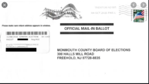
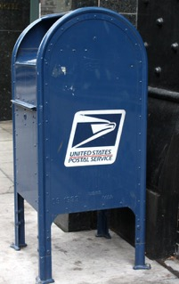
Mail it or drop it off!
Nearby drop-off sites:*
Mon. Co. Sheriff’s Shore Area Communications Center
1825 Rte. 33, Neptune
Eatontown Municipal Bldg.
47 Broad St., Eatontown
* Other sites:
Englishtown, Howell, and Hazlet
Drop your ballot in a mailbox or drop-off site
Congratulations, you’ve cast your VOTE!
DEADLINE: Postmarked by Election Day.
For 2020 Primary, deadline for receipt by
County is 7 days after polls close.
MAIL EARLY TO AVOID ANY PROBLEMS!!!!!!!!
Changed from 2 days for the 2020 Primary
Notes:
For the 2020 Primary, secure DROP-OFF sites will be set up around the County where you can take your mail-in ballot. If you have texted the League of Women Voters at 732-927-1131 for any reason, the League will alert you by text to any changes to the process.
You can also can mail your ballot directly to the County. The state has arranged for the postage to be paid on mail-in ballots for the 2020 Primary and General Election. You do not have to put any stamps on the envelope.
Normally, the County will accept ballots up to 48 hours after Election Day IF THE BALLOTS WERE MAILED BY ELECTION DAY. For the 2020 NJ Primary, that deadline has been extended to seven days after the polls close to accommodate the volume of VBM ballots expected based on the changes to this year’s process. To avoid any problem, mail your ballot well in advance.

Slide 16
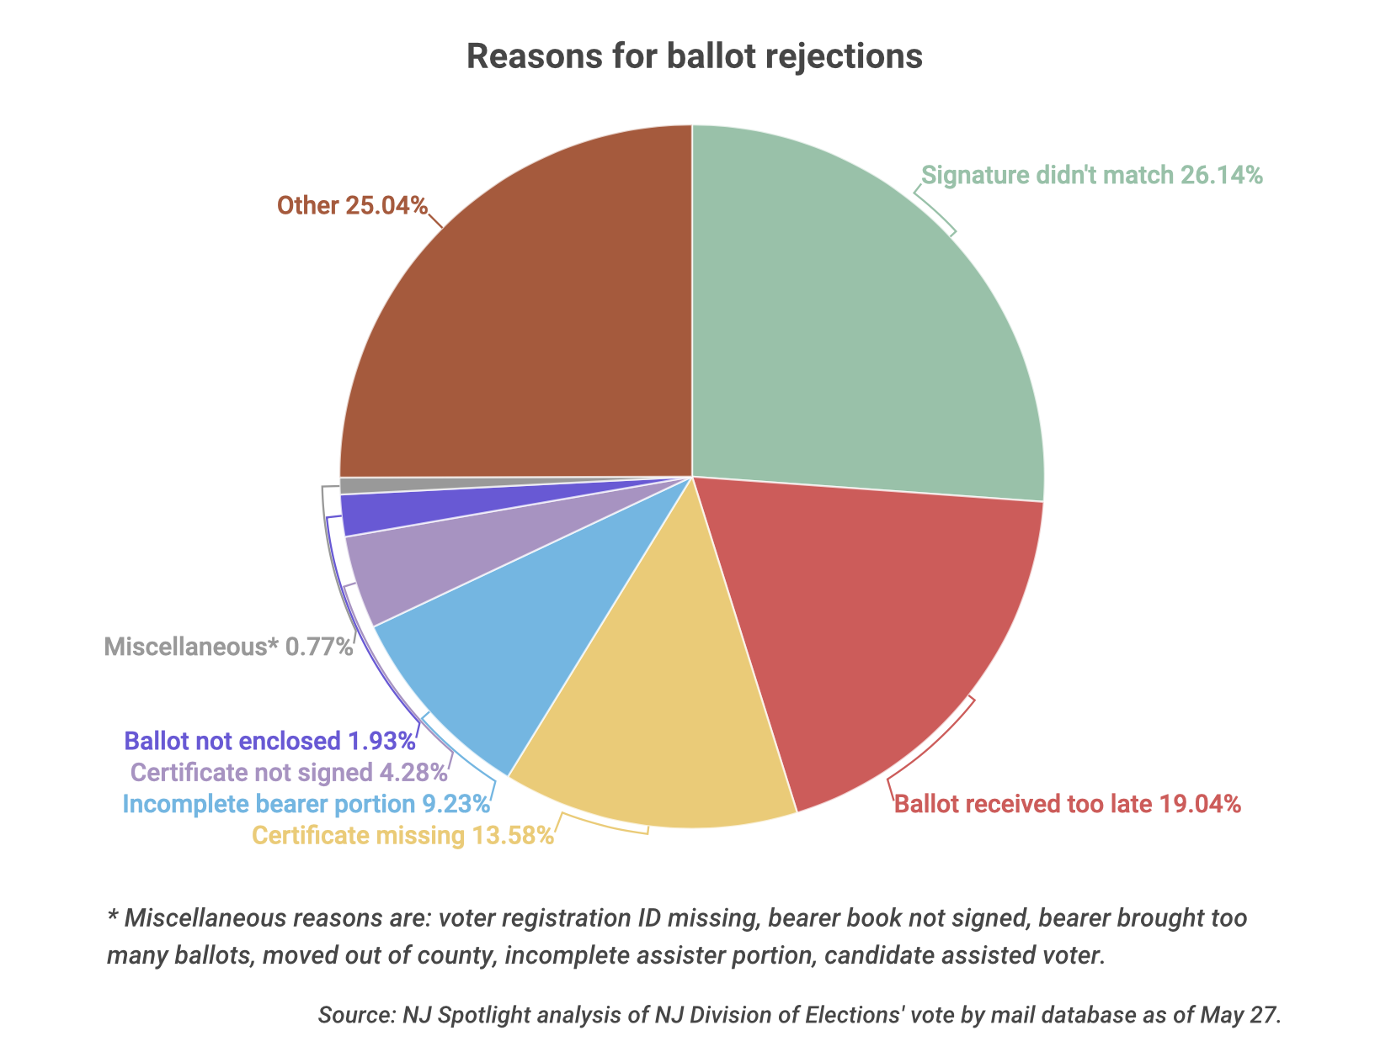
Mistakes mean rejection
The stakes are high
119,000 ballots cast
(17.4% of those sent; 31 communities)
11,453 (9.6%) rejected*
May 2020 NJ all VBM local nonpartisan elections
Reasons for ballot rejections
* Includes 800 rejections in Paterson election—ballots found in bundles in mailboxes. If Paterson removed, rejection rate was 8.1%
Miscellaneous 0.77%
Voter registration ID missing, Bearer book not signed, Bearer brought too many ballots, Moved out of county, incomplete assister portion, candidate assisted voter
Signature mismatch 26.14%
Ballot not enclosed 1.93%
Certificate not signed 4.28%
Ballot received too late 19.04%
Incomplete bearer portion 9.23%
Certification missing 13.58%
Notes:
NJ Spotlight, June 10, 2020: Colleen O’Dea, “One in 10 Ballots Rejected in Last Month’s Vote-by-Mail Elections.”
May all-VBM local elections exceptionally higher rejection rate. (3% in 2018 General Election)
Most common reasons: Signature mismatch, ballot arrived late. Required certificate was not enclosed
LWLVNJ and NAACP are plaintiffs in suit against the state demanding that voters whose ballots have been rejected have a chance to “cure” (correct) the problem in time for the primary election

Slide 17

How to know your ballot was counted
  To learn if your mail-in ballot was accepted/rejected and why, CALL:
    The state of New Jersey at
    1-877-NJVOTER (1-877-658-6837)
        -OR-
    Monmouth County Board of Elections
    732-431-7802, x. 7150
(You will be notified by mail if your ballot is rejected.)
Notes:
For the 2020 Primary, secure DROP-OFF sites will be set up around the County where you can take your mail-in ballot. If you have texted the League of Women Voters at 732-927-1131 for any reason, the League will alert you by text to any changes to the process.
You can also can mail your ballot directly to the County. The state has arranged for the postage to be paid on mail-in ballots for the 2020 Primary and General Election. You do not have to put any stamps on the envelope.
Normally, the County will accept ballots up to 48 hours after Election Day IF THE BALLOTS WERE MAILED BY ELECTION DAY. For the 2020 NJ Primary, that deadline has been extended to seven days after the polls close to accommodate the volume of VBM ballots expected based on the changes to this year’s process. To avoid any problem, mail your ballot well in advance.

Slide 18
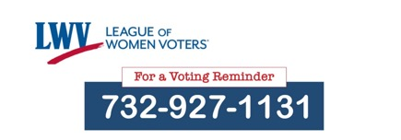
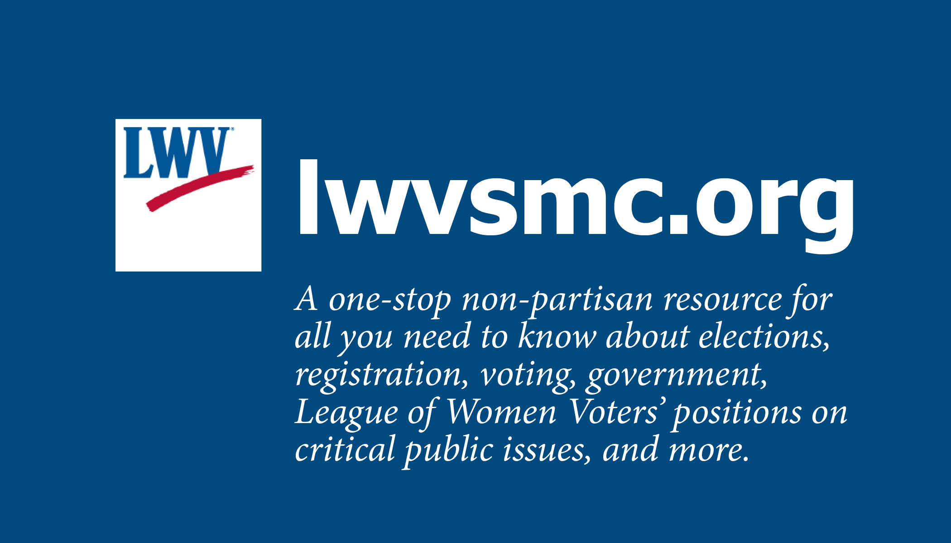

Text for help

Slide 19


It’s time to begin registering voters for the General Election
PRIMARY
July 7, 2020
Registration Deadline
GENERAL ELECTION November 3, 2020
Registration Deadline
19
Notes:
(THIS SLIDE IS ANIMATED)
The situation is urgent! The shutdown and dangers imposed by Covid-19 pose a threat to our elections in a critical election year. States—including New Jersey-- are having to redesign the voting process to allow people to vote by mail and to provide safe polling places. The changes are leaving voters uncertain about how things will work—and can lower voter turnout. Two important elections are affected. One is just around the corner.
Primary election:
The Primary is an election run by the major parties—the Democrats and the Republicans—to choose their candidates to run in the General Election in November. You must be affiliated with a Party to vote in its election. Because of the coronavirus crisis, the Governor of New Jersey moved the Primary from June 2 to July 7.
General election: Individuals vote their choice for President, Senator and Congressperson, and offices at the state, county, and local levels. In the general election, you do not have to declare a party. You can vote for a candidate from any party. The General Election is set by law as the first Tuesday after the first Monday in November. Some or all of the new procedures installed for the Primary may still be in effect for the 2020 General Election.
Public questions: In the general election this year, you will also be voting on two state-wide public questions: whether or not to give a property tax deduction and exemption for veterans who served during peacetime rather than only wartime, and whether or not to legalize marijuana.

Slide 20


Are you eligible to register?
Yes! If you are . . .
A U.S. citizen
At least 17 years old
(But you can not vote until you turn 18)
A resident of the county for 30 days before the election
Not serving a prison sentence for a felony
NEW ! You can vote if you are on parole or probation but you need to register—even if you were registered before.
20
Notes:
Voting eligibility
First things first. A voter must be REGISTERED. This slide lists the voter registration requirements in New Jersey.
A recent change in requirements for voting (effective March 2020) is that people who are on parole or probation can vote, but they MUST REGISTER OR RE-REGISTER, if they were previously registered.

Slide 21
Are you already registered?
If you got your NJ driver’s license since 2018, you were registered to vote—unless you chose to OPT OUT (not to be registered).
If you registered recently, you received a voter acknowledgment card in the mail. If you registered in the past, you may have received a voter id card. (Neither of these cards is required to actually vote.)
If you are 18 years old or older, you can check at vote411.org.
If in doubt, REGISTER
21
Notes:
Checking to see if someone is registered
Some people will be unsure whether or not they are registered. You can use the online resources below to see if the person you are helping is already registered or needs to register now.
https://www.nj.gov/state/elections/voter-registration.shtml - for people who live in NJ
VOTE411.org is a website developed by the League of Women Voters. It is useful anywhere in the US and has all the election information needed.
In all of these cases, you simply enter your name and birthday, and a search will reveal if you are registered. Once a person is registered, they do not need to reregister unless their name, address, or signature changes or they wish to change their party affiliation.
NOTE: NJ allows 17-yer-olds to register, but they cannot vote until they are 18. A 17-year-old who has registered will not appear on the state list until they turn 18. If the teen is uncertain, there is no harm in re-registering.

Slide 22
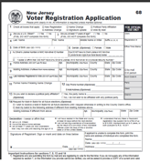
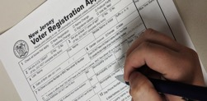
How do you register to vote?
Online registration is coming to NJ, possibly in July 2020
Get a registration form
Fill it out
Mail it in
For now
22
Notes:
Three steps (explained in the following sides)

Slide 23
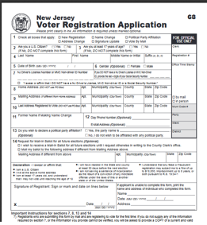
How to get the Voter Registration Application From Home
Print from this website:
    https://www.state.nj.us/state/elections/voter-registration.shtml
  For English or Spanish: Select “Monmouth County” (or your county)
  For other languages:
  Scroll to the bottom of the County List and
  click on “Statewide Voter Registration Forms”
      - OR -
Text “REGISTRATION FORM” to the League of Women Voters
(732-927-1131) and they’ll be in touch and mail one to you
23
Notes:
Registering to Vote/ Updating a Registration
In normal times, you can pick up a Voter Registration Application in person at the County Board of Elections Office at the county seat (Freehold for Monmouth County) or your town hall, or at registration drives held by the League of Women Voters and others.
To get a Voter Registration Application from home:
Find the form online – Forms in 14 languages are available on the NJ state elections site which can be reached by entering the state website URL on the slide or by simply Googling “NJ Voter Registration Form” to get to the state website. Scroll down to your County and chose either English or Spanish. Other languages are available under “Statewide forms” at the end of the list of counties. The forms can be filled out (but not submitted) online, downloaded, and printed (at 100% size). By mid-July, you will able able to complete AND SUBMIT the voter registration application online at the state website. But we are urging people to register NOW for the upcoming primary election.
--OR--
Text “REGISTRATION FORM” to the League of Women Voters at 732-927-1131. They’ll be in touch and mail a Voter Registration application to you.

Slide 24

Use pen, not pencil!
How to fill out the Voter Registration form
Online form
VIDEO
Notes:
Here you show students how to complete a VOTER REGISTRATION FORM. There are three options for how to do this:
Stay on this slide and talk about each field on the form.
Click on the “Online Form” hyperlink. It will take you to an interactive form on which you can fill in, real time, explaining as you go. If this is your choice, print a copy of the slide to support you as you narrate filling in the form. You must be in the “Slideshow” mode for the hyperlink to work.
Click on the “VIDEO” hyperlink and play the League of Women Voter video (~8 minutes) showing someone filling in the form. You must be in the “Slideshow” mode for the hyperlink to work.
NOTE: How you return to the Slideshow from the hyperlinks varies, depending on your hardware and software platforms. How it works for you may influence your choice of option (staying on the slide, filling in the online form and narrating yourself, or showing the video.)

Slide 25
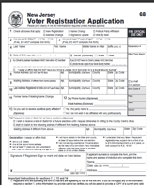


Mail it!
Fold and tape (not staple) your form
and drop it in a mailbox.
Your form is already addressed and stamped.
Once registered, you stay registered and do
not need to submit another form unless you change your address, name, signature, or party affiliation.
DEADLINE: 21 days before Election Day
October 13, 2020 for the General Election
25
Notes:
Mail your completed Voter Registration Form/Application
It is vitally important that you follow the directions for submission exactly. If you print the form yourself, you will have two pages. Fold them so that the address shows on the outside when it is sealed. Tape the pages so that they don’t come apart in the mail.
There are deadlines for registration. In NJ, your voter registration application must be received by the county Board of Elections 21 days prior to the election in which he or she wishes to vote. The registration deadlines for the Primary and General Election are shown on the slide.

